Slide 1

Forensics – Beyond CSI
Ronald J. Leach
Notes:
Why me? I watch most of the same shows and read the same books and have a niece in forensics. I am an expert on a portion of computer forensics. I took an adult ed course in forensics.

Slide 2
Definition of forensics
The application of a broad spectrum of sciences to answer questions of interest to a legal system in relation to a crime or a civil action.
(source: Wikipedia)

Slide 3
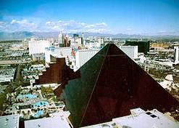
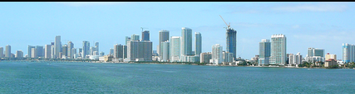
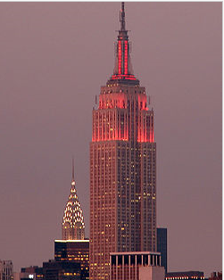
CSI

Slide 4
Crime is a growing industry
Notes:
Many applicants for college forensics programs
Many job opportunities

Slide 5
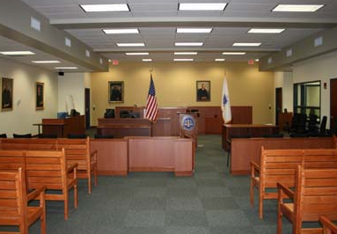
Notes:
Many juries used to require confessions for conviction (“Perry Mason Syndrome”)
Now they need forensics evidence, especially DNA.
Expert witnesses: have more knowledge than a typical layperson, testimony can explain the science. Experience, education, credentials, publications matter. Accepted by opposition.
Identification (Facial recognition software)? Polygraphs, Fingerprints?

Slide 6
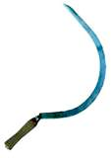
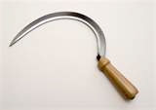
Notes:
Earliest known case of forensics - 1248 Song Dynasty. Worker is murdered using a sickle. All worker’s sickles were clean. Expert witness was called in - flies smelled the blood and identified the sickle and, presumably, its user.

Slide 7
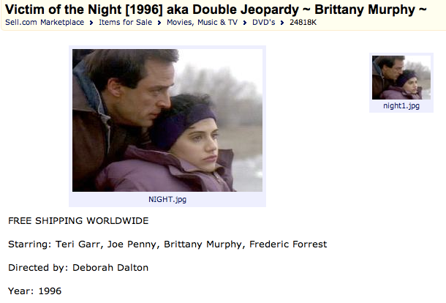
Notes:
Real case of a staged crime scene in Baltimore County Md. Staging was done by a person who falsified credentials and trained many forensics experts in Baltimore County and elsewhere. Look up Joe Papera. Discuss the hats. Murder-suicide? Double Murder? Staged?

Slide 8
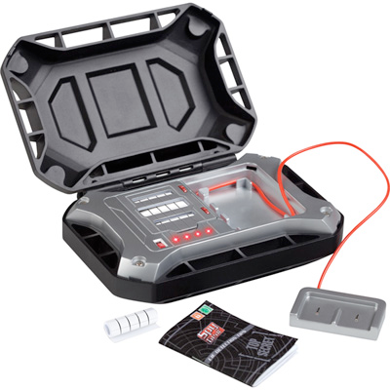
Notes:
My wife, drugs, lie detectors, and a famous murder case.
Now polygraph, not lie detector.

Slide 9
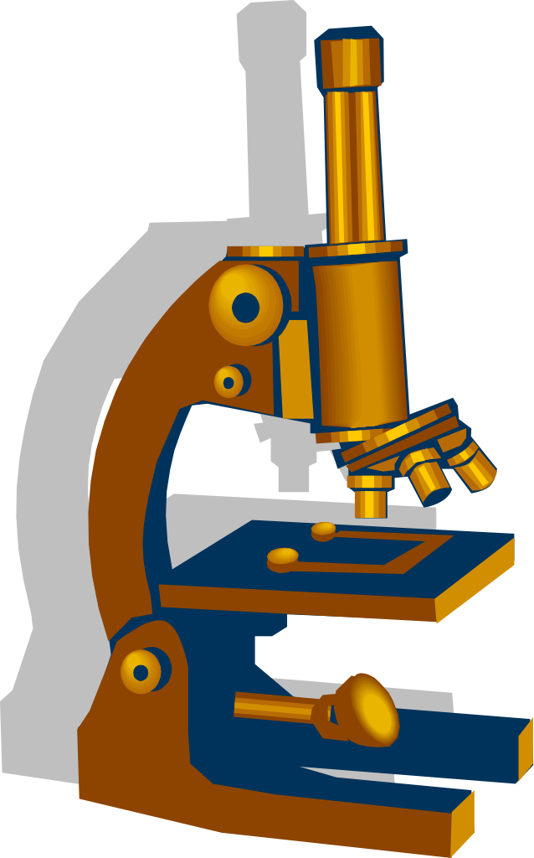


Slide 10
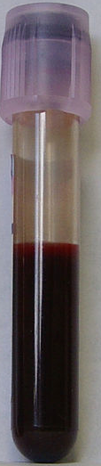
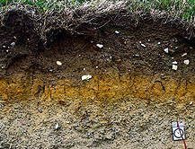
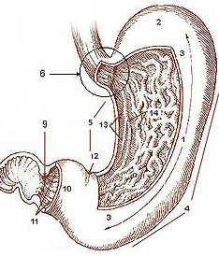
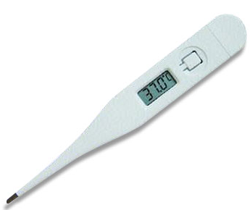
Physical Forensics – based on victim
Notes:
Ear prints were used recently in Guatemala to identify adoptees.
Teeth? How about bite marks? How about photos of bite marks because the bite marks had degraded? (Ted Bundy admitted to a dozen decapitations.)

Slide 11

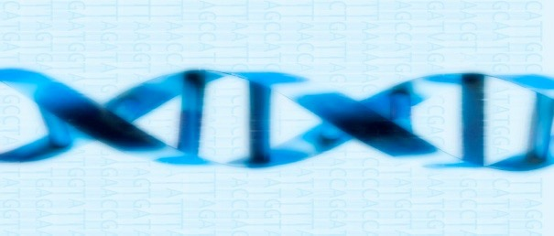
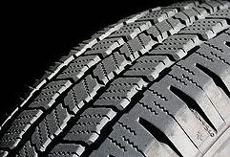

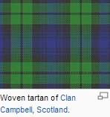
Physical Forensics – based on crime scene
Notes:
Hair samples, Other bodily fluids Doggie doo on a shoe, compared to 89 piles. Enzyme samples were matched to the perp’s dog. Long running feud between victim and perp.
Dog poop does not contain DNA. Admissible? (generally accepted) Perp confessed.

Slide 12
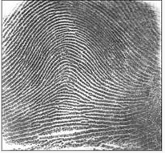
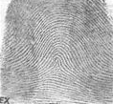
Arch Tented arch

Slide 13
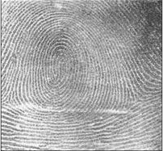
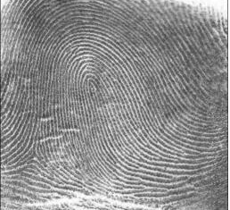
Whorl pattern Loop

Slide 14
Melendez-Diaz v. Massachusetts
Notes:
2009 Supreme Court decision:
Crime lab reports may not be used unless analysis who created them testify. Analysts are subject to cross-examination.

Slide 15
National Academies report
“Strengthening Forensic Science in the United States”
Notes:
Justice Scalia: Forensic evidence is not uniquely immune from the risk of manipulation.”

Slide 16
Accreditation and certification
Notes:
Forensic laboratories can be accredited.
Forensic anthropologists can be “board certified.”

Slide 17
Are forensics degree programs accredited?
Notes:
Some discipline-specific organizations have developed standards for forensics degree programs. Not so much on the US national level as of yet.

Slide 18

Physical Forensics –based on suspects
DNA
Blood
Others

Slide 19
Some DNA history
1953: Watson and Crick (and Franklin) describe DNA structure
2003: Human Genome Project essentially complete
2012: Large database on information in “junk DNA”

Slide 20
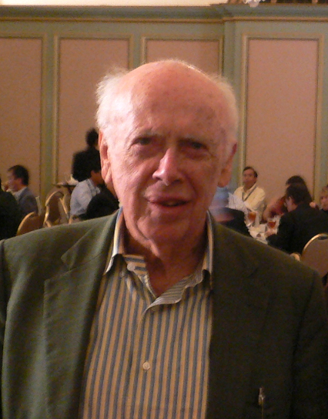
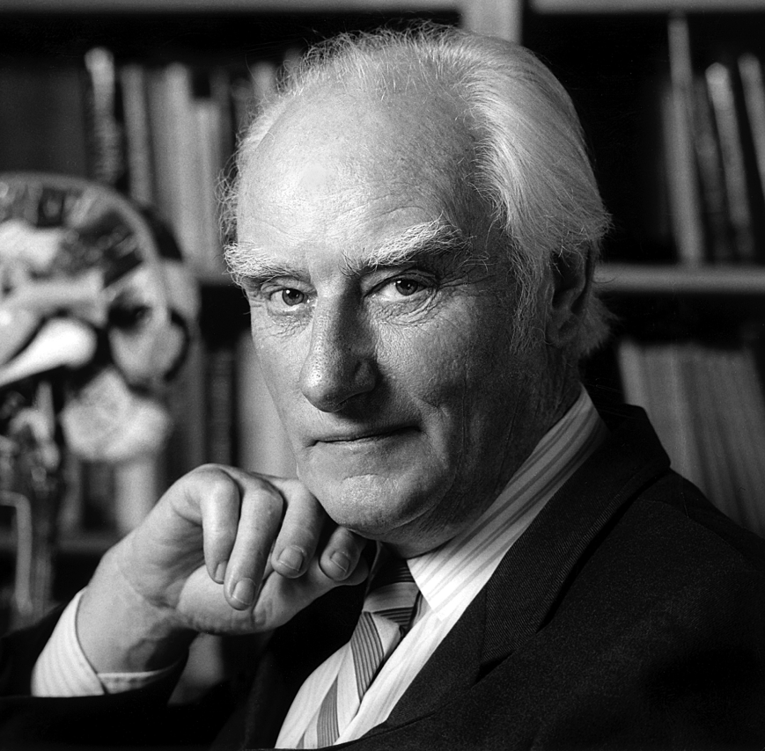
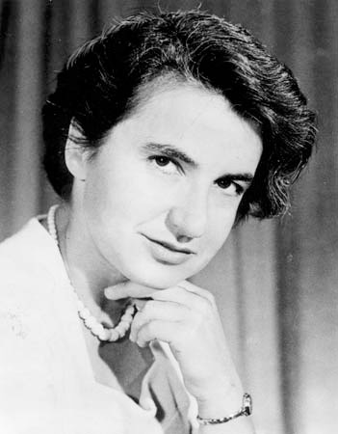
Courtesy: Wikipedia
Notes:
James Watson, Francis Crick, and Rosalind Franklin.

Slide 21
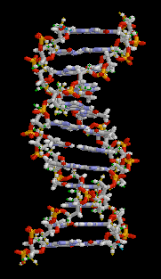
What is DNA?
Long twisted sequences of 4 chemicals, labeled A, C, G, and T – double helix

Slide 22
The Innocence Project
Notes:
255 people exonerated via DNA testing
17 of the 255 people exonerated spent a combined 187 years on death row.
Some came within days of scheduled execution.

Slide 23
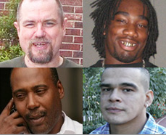
Curtis McCarty
Ryan Matthews
Earl Washington
Rolando Cruz

Slide 24
Views of Brandon Garrett (Innocence Project and VirginiaLaw Faculty)
Notes:
Few crimes have usable DNA evidence
“More than half of the first 250 people exonerated were guilty of erroneous forensic evidence.”
95% of criminal defendants plead guilty - some can’t access DNA evidence.
“DNA testing is not immune from error... A Houston crime analyst told a jury that only an identical twin could have the same DNA - wrong analysis.” The American Journal of Human Genetics, Volume 82, Issue 3, 763-771, 14 February 2008. Phenotypically Concordant and Discordant Monozygotic Twins Display Different DNA Copy-Number-Variation Profiles

Slide 25
Automated matching
Every Monday morning, the FBI’s Combined DNA Analysis System (CODIS) compares DNA from unsolved crimes to the existing database.
Notes:
In 45% of DNA tests that exonerated people, matches of this database identified the real culprits

Slide 26
How certain is DNA analysis?
How many markers are necessary to be sure of a match?
Will there be better scientific understanding of DNA matches?
Notes:
Reports describe the matches of JUNK DNA. Often use probability to describe.

Slide 27
Common to all criminal forensics
Chain of evidence

Slide 28
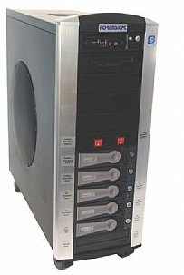
Chain of Evidence: Computer Forensics
Where you’ve been
What you sent
What you wrote

Slide 29
Murder?, You Solved

Slide 30


Slide 31
Thank You!

