Slide 1
Genealogy: Who Do You Think You Are?
Ronald J. Leach

Slide 2
About me
All aptitude tests: I should be a historian
Professor (retired) for over 41 years
  Math: 16+ years
  Computer Science: 25+ years
  Recently combined computers, genealogy, …

Slide 3
More about me
Amateur genealogist
  Researched family
  Author, 2 genealogy books
  Editor, Md. Gen. Soc. Journal, Newsletter
  Editor, transcription project

Slide 4
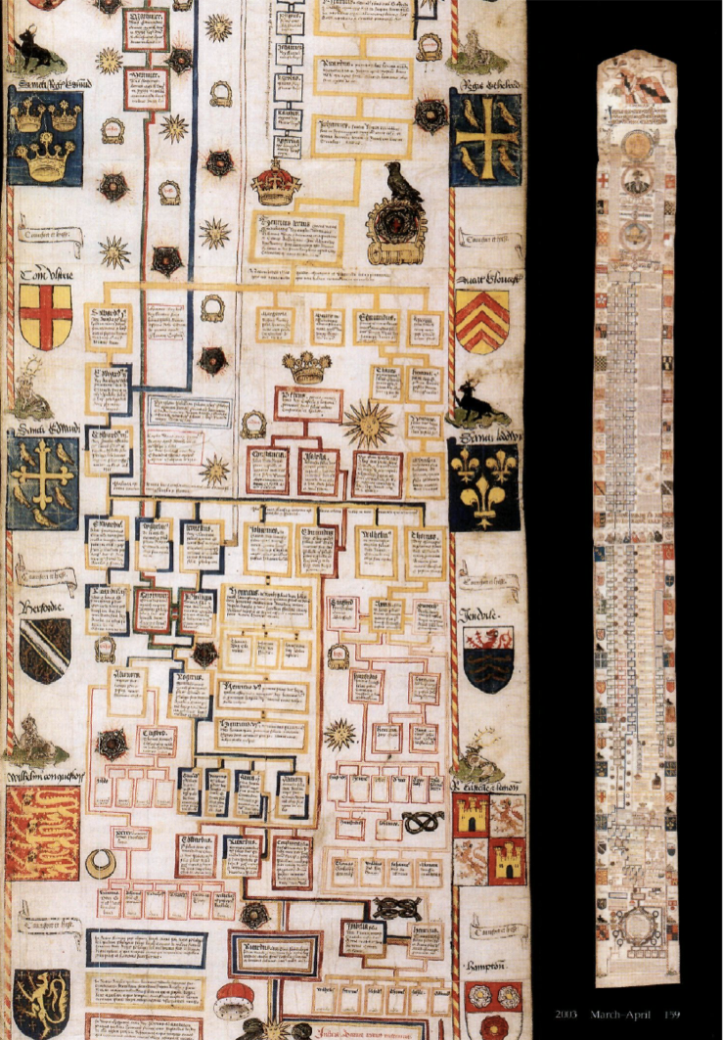

Slide 5
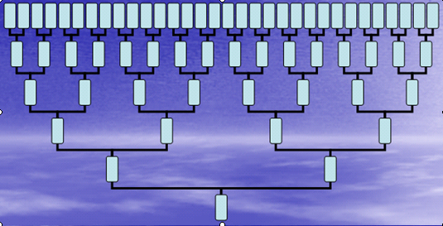

Slide 6
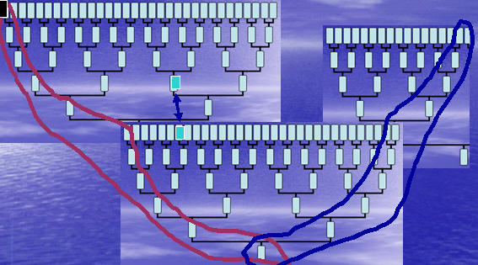

Slide 7
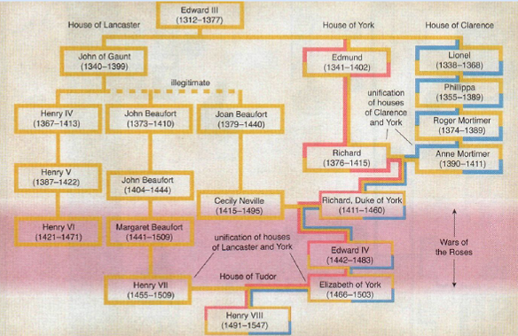
Manrubia, Derrida, & Zannette, “Genealogy in the age of Genomics,” Amer. Scientist

Slide 8

Census
Immigration
Death
Birth
Marriage

Slide 9

Census
Immigration
Death
Birth
Marriage
DNA

Slide 10
Some other useful records
Military records
Probate records
Land records
City directories
Religious records
Genealogies, …

Slide 11
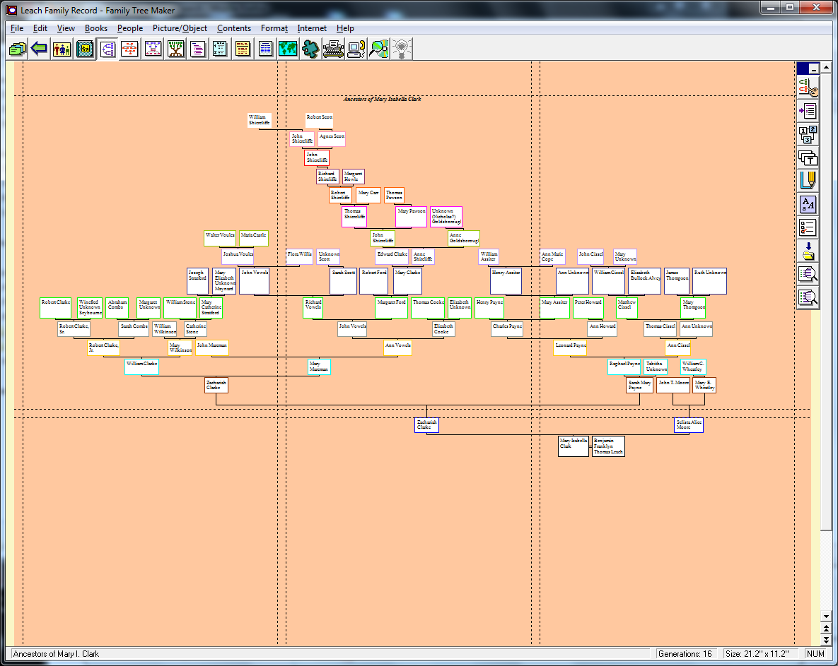

Slide 15
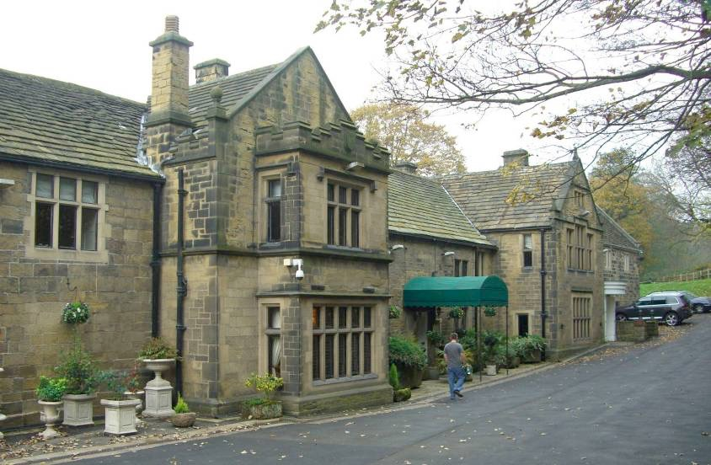
Picture courtesy Mick Knapton, Wikipedia

Slide 16
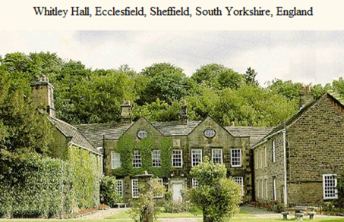

Slide 17
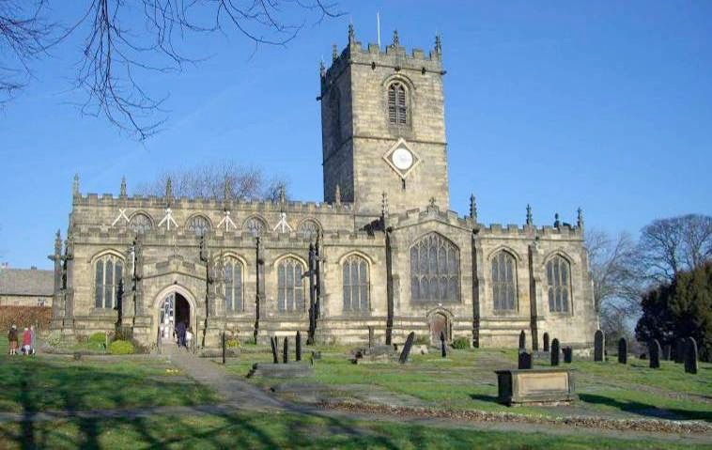

Slide 19
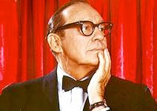

Slide 20
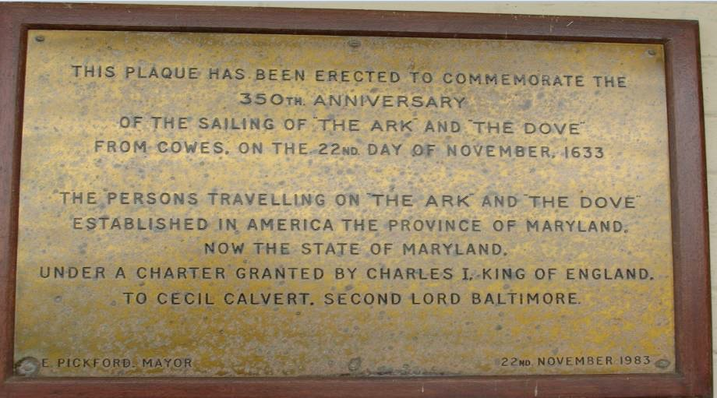

Slide 21
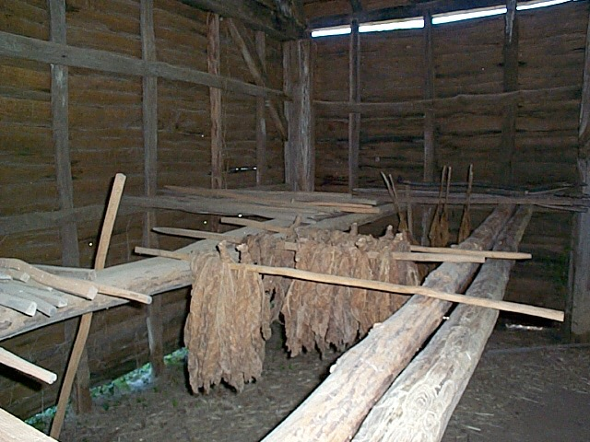

Slide 22
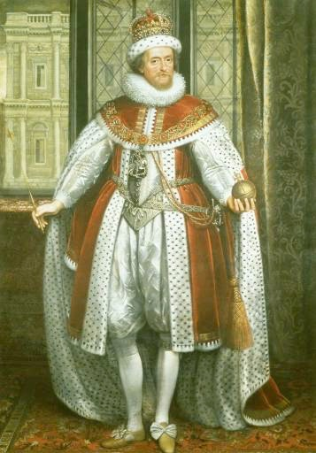
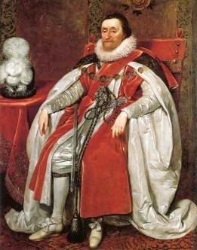
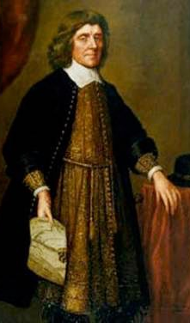
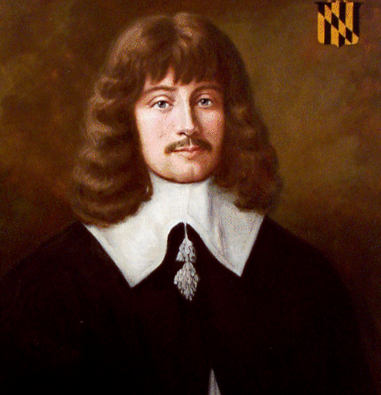
James I, Charles I, Cecil Calvert, Leonard Calvert: courtesy Wikipedia

Slide 23
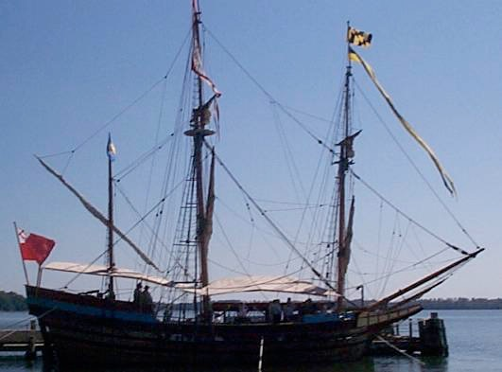

Slide 24
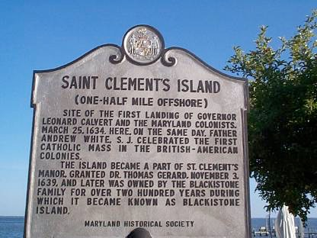
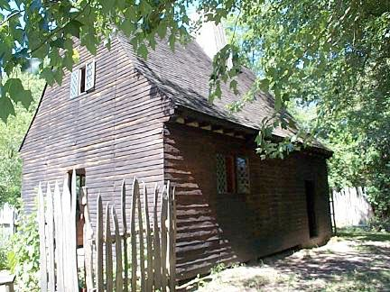
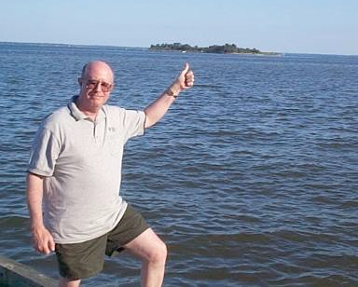
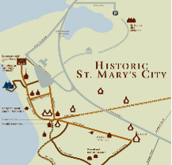

Slide 25

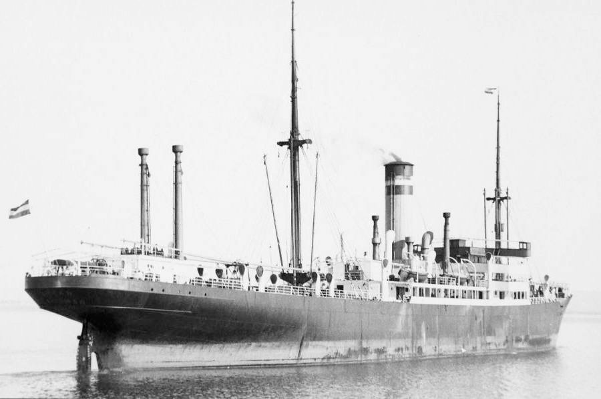

Slide 26
What did I expect?
A widow
What did I find?

Slide 27
What did I expect?
A widow
What did I find?
A secret marriage of her husband!
A divorce
Marriage to my grandfather

Slide 28


Slide 29
Thank You!

