Slide 1
Genealogy and DNA
Ronald J. Leach

Slide 2
Some DNA history
1953: Watson and Crick (and Franklin) describe DNA structure
2003: Human Genome Project essentially complete

Slide 3
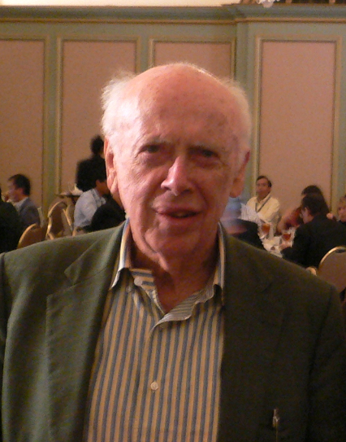
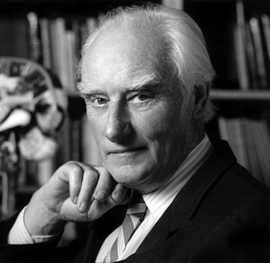
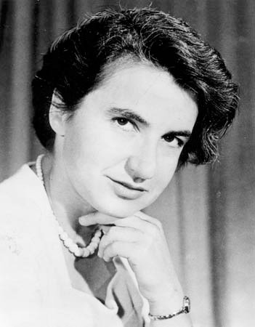
Courtesy: Wikipedia

Slide 4
What is DNA?

Slide 5
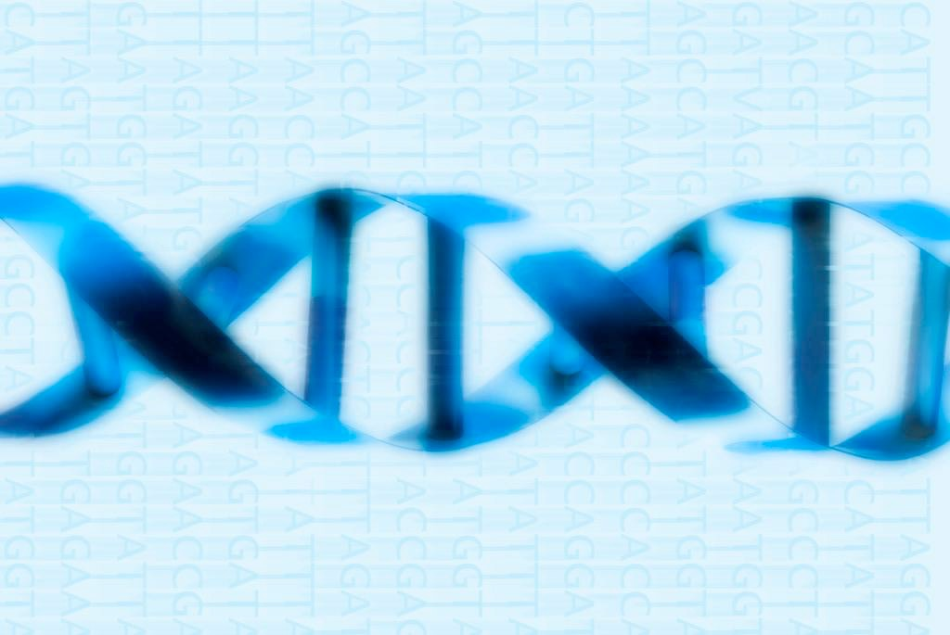
What is DNA?
Long twisted sequences of 4 chemicals, labeled A, C, G, and T – double helix

Slide 6
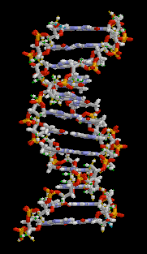

Slide 7
Computers can store huge amount of information
Everything in a computer is stored as a sequence of 0s and 1s:
  programs, documents, pictures, music, …

Slide 8
DNA can store more “information”
Everything in DNA is stored as a sequence of As, Cs, Gs, and Ts.
  Much more “information” than the same length sequence of 0s and 1s.
  Potentially huge amount of computing and power in “genetic computer”

Slide 9
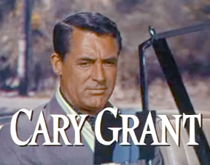

Slide 10
How Old Cary Grant

Slide 11
How long is DNA?
If the DNA inside one cell was stretched out end to end, it would be approximately

Slide 12
How long is DNA?
If the DNA inside one cell was stretched out end to end, it would be approximately six feet long!

Slide 13
Look for patterns in DNA
ACGTTGCAAACCGGTTACGTATCGA….
ACGTCGCAATCCGGTTACGTATCGA….
ACGTTGCAACCCGGTAACGTATCGA….
CGTTGCAAACCGGTTACGTATCGAC….

Slide 14
DNA information
ACGTTGCAAACCGGTTACGTATCGA….
CGTTGCAAACCGGTTACGTATCGAC….

Slide 15
DNA information
ACGTTGCAAACCGGTTACGTATCGA….
CGTTGCAAACCGGTTACGTATCGAC….

Slide 16
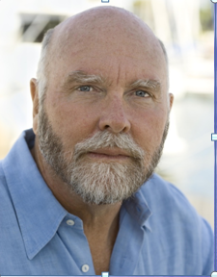
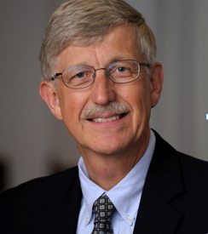
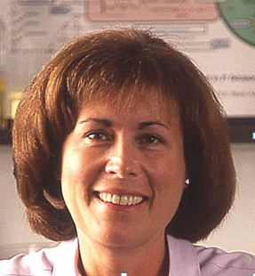
Craig Ventner, Francis Collins, Clare Fraser-Liggett
Courtesy, wikipedia

Slide 17
DNA is a “double helix”
When stretched out (like a ladder) the rungs are the “bases”
Different sides of the ladder have different A, C, G, T sequences
Matching occurrences of A and T, or G and C on different sides of the ladder are “base pairs”

Slide 18
DNA is a “double helix”
The sequence of base pairs contains genetic information
Unique sequence (except for identical twins)

Slide 19
What is DNA?
“Every” cell in our body (except eggs and sperm) contains 23 pairs of chromosomes
Each pair of chromosomes consists of:
  one chromosome from father
  one chromosome from mother

Slide 20
What is DNA?
To a computer scientist:
As a very, very, very long string of:
  A
  G
  C
  T

Slide 21
How is DNA searched?
Search for special substrings
DNA is cut up and recombinined
DNA labs look for:
  where a DNA strand of is broken and then joined to the end of a different DNA molecule
  regions where base pairs repeat

Slide 22
How is DNA searched?
Matching the substrings is hard
  Process is computer intensive
  New methods are being developed constantly

Slide 23
The 23rd chromosome pair is special
For males, one X-chromosome and a Y-chromosome
For females, two X-chromosomes
Only males contribute Y-chromosome
Y-chromosome carries information from a male's paternal line

Slide 24
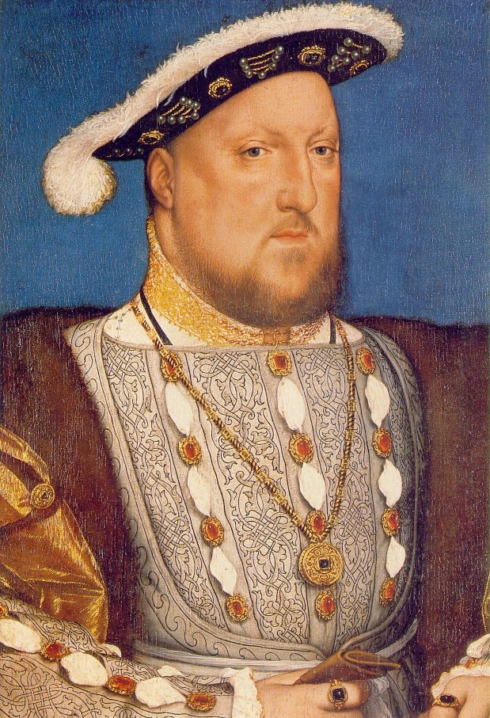

Slide 25
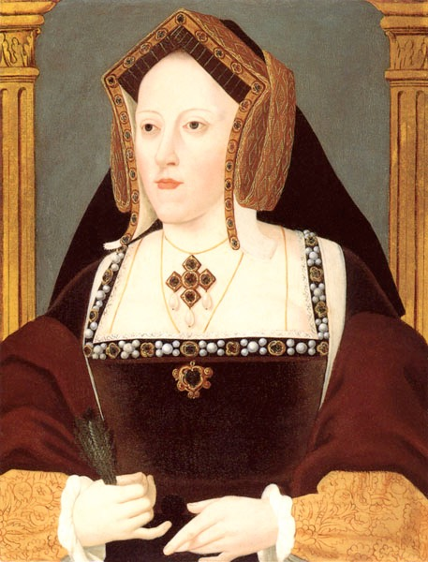
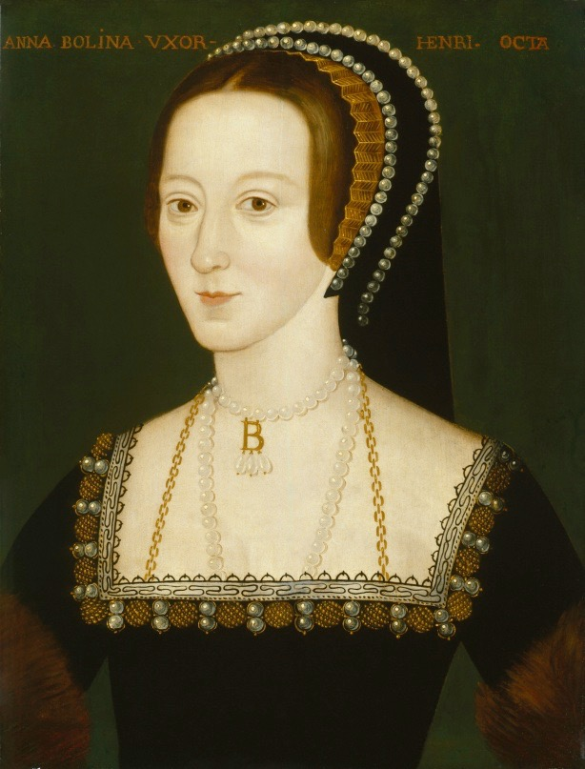
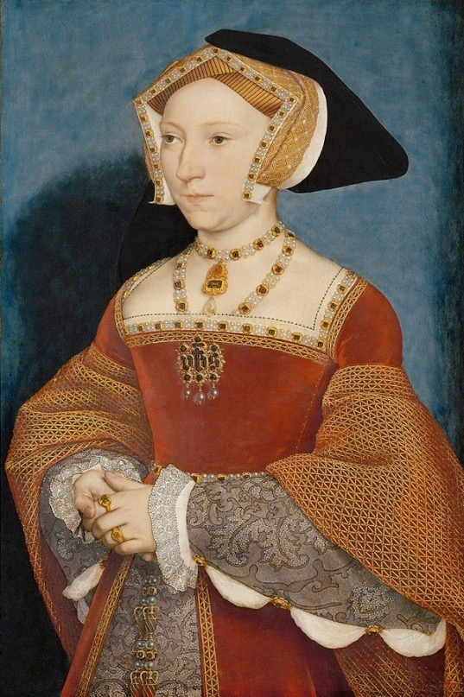
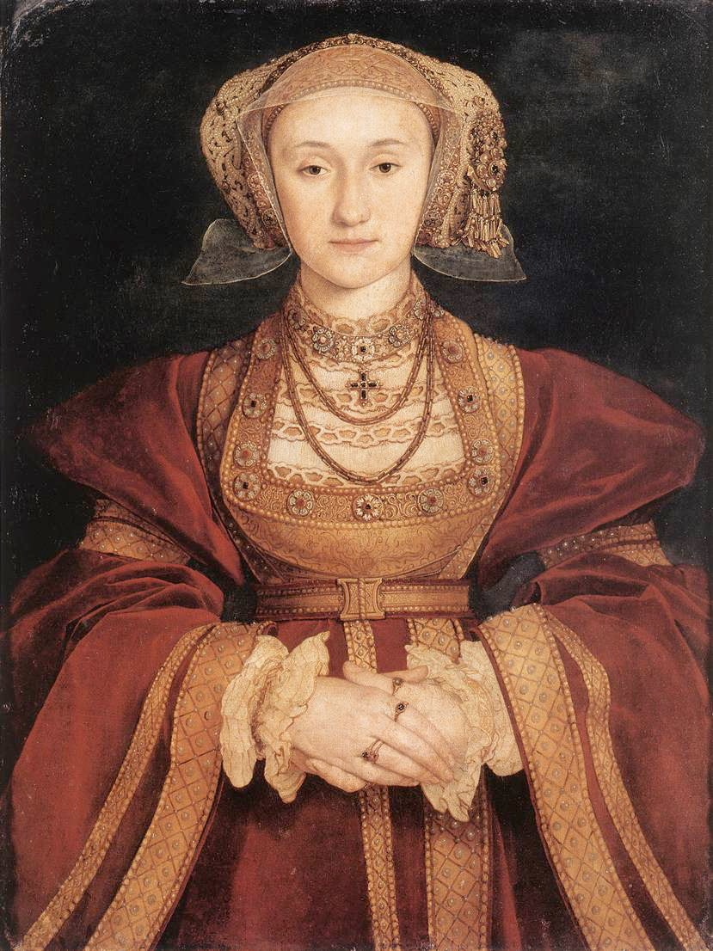
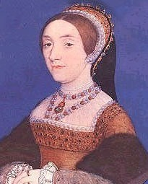
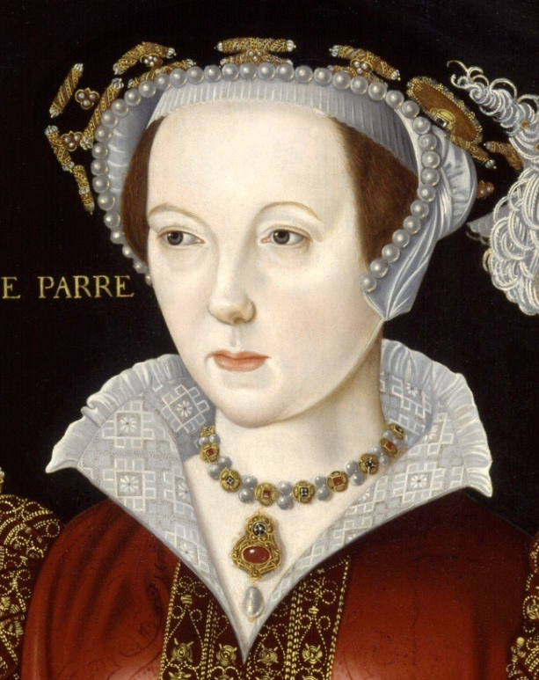

Slide 26
Types of DNA tests in genealogy
Relationship tests
Y-chromosome matching –inherited only from father
Mitochondrial DNA matching –inherited only from mother
Statistical DNA matching – match DNA with sample populations

Slide 27
DNA testing for relationships

Slide 28
Are they related?

Slide 29
Are they related?

Slide 30
Are they related? DNA can tell (!!)

Slide 31
Science marches on!

Slide 32
Y-chromosome DNA testing

Slide 33
DNA tests: Y-Chromosome
Y-chromosome matching – inherited by male offspring only from father
Y-chromosome is essentially unchanged from generation to generation
Tests look for specific matches of DNA in substrings of A, C, G, T

Slide 34
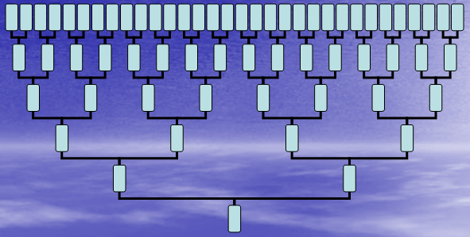
Y-Chromosome, fraternal line

Slide 35
DNA tests: Y-Chromosome
Only looking at father’s father, etc.
A tiny portion of genetic heritage
  Generation % of ancestors
  4 6.25%
  8 0.39%
  12 0.02%

Slide 36
Types of results to expect from genealogical test of Y-chromosome
Your father’s direct line through his father, his grandfather, etc. shows an ancestry from the region known as “yyy”

Slide 37
Vocabulary: Haplogroup
A haplogroup is:
  the DNA equivalent of a “tribe“
  an identified ethno-geographic group
  associated with the presumed migratory path of ancient populations

Slide 38
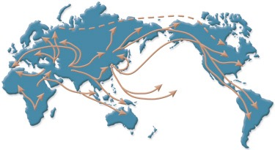
Courtesy University of Utah

Slide 39
How much does Y-Chromosome DNA testing cost?
To cover a single ancestor, using patriarchal lineage:
  Test Y-chromosome (standard matching of 33 markers) for paternal lineage of males: $75-150
  Same test as above, but match 46 markers: $100-200

Slide 40
Mitochondrial DNA (mtDNA) Testing

Slide 41
Mitochondrial DNA tests
mtDNA is different from ordinary (‘nuclear”) DNA
mtDNA – is inside the nucleus of a cell
mtDNA – inherited only from mother

Slide 42
Mitochondrial DNA, maternal line

Slide 43
DNA tests: mitichondrial DNA
Only looking at mother’s mother, etc.
A tiny portion of genetic heritage
  Generation % of ancestors
  4 6.25%
  8 0.39%
  12 0.02%

Slide 44
Types of results to expect from genealogical test of mtDNA
Your mother’s direct line through her mother, grandmother, etc. shows an ancestry from the region “mmm”

Slide 45
How much does Mitochondrial DNA testing cost?
Mitochondrial DNA for maternal lineage for both males and females: $90-200

Slide 46
What about multiple generations?

Slide 47
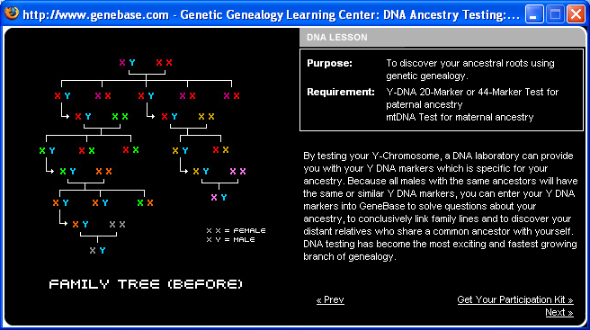
Test DNA Y-Chromosome on several ancestors in different generations $$$
Courtesy www.dnaancestryproject.com

Slide 48
Test mtDNA on several ancestors in different generations
Courtesy www.dnaancestryproject.com

Slide 49
Statistical DNA Testing

Slide 50
Statistical DNA tests
Match DNA fragments with those of selected populations to determine populations your ancestors came from
Requires that the populations sampled have been analyzed already
Doesn’t work well if the populations are too broad (genetically)

Slide 51
Types of results to expect from a statistical DNA genealogical test
Some (reported) percentage of your ancestors came from the region “xxx”
Some (reported) percentage of your ancestors came from the region “yyy”
Some (reported) percentage of your ancestors came from the region “zzz”
…

Slide 52
Statistical DNA tests
Interpretations are more controversial than Y-chromosome and mtDNA testing
Analysis will get better as more data is obtained on ethnic populations

Slide 53
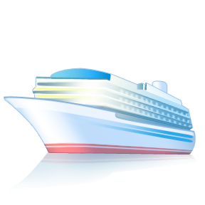

Slide 54
Thank You!

