Slide 1
Genealogy with the Internet

Slide 2
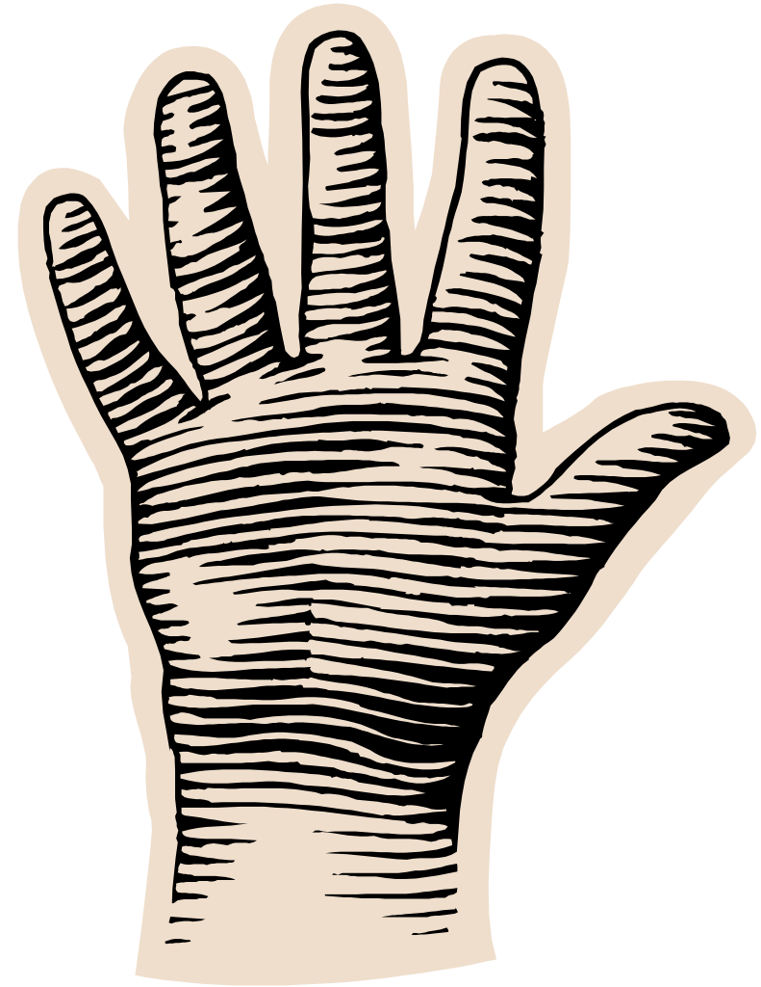
Census
Immigration
Death
Birth
Marriage

Slide 3
Census
Immigration
Death
Birth
Marriage
DNA

Slide 4
A few other useful records
Military records
Probate records
Land records
City directories
Genealogies

Slide 5
The big five
Major portions of most can be found on the Internet.
Not so true for the other, less commonly used records

Slide 6
Internet records
Government sites (federal)
Government sites (state and local)
Commercial sites
Free sites

Slide 7
Internet records: Government
Vital records
Many must be searched manually – not indexed by search engines such as Google
Many require fees for detailed information
  Sometimes only a brief index is available on-line

Slide 8
The National Archives
www.archives.gov/genealogy/start-research/
How-to information
Data

Slide 9
Internet records: some free sites
Mormon church: familysearch.org
stephenmorse.com
rootsweb.com is now rootsweb.ancestry.com

Slide 10
Internet records: Commercial
Ancestry.com
Genealogy.com
Footnote.com
Heritagequest.com
Many others

Slide 11
Internet records: Commercial
Special purpose sites:
  Permutations of names on Ellis Island lists
  Hamburg immigration lists
  Foreign sites, especially UK
  Many others

Slide 12
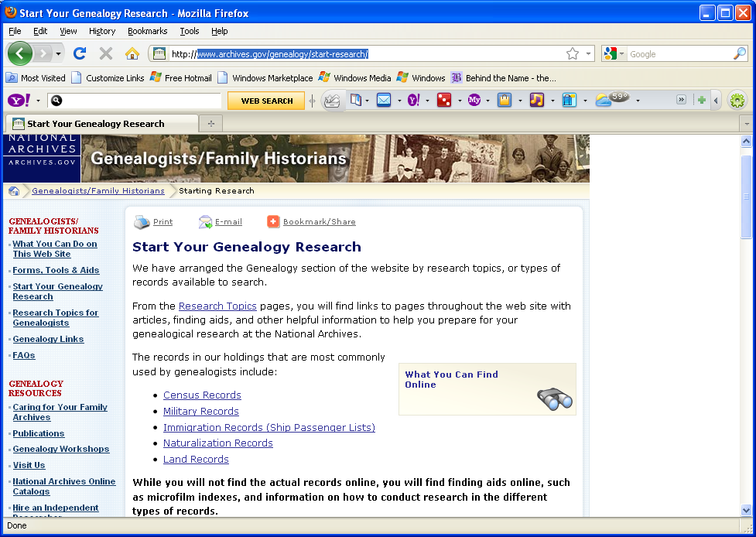

Slide 13
The National Archives
Has indexes on-line
Focuses on microfilms

Slide 14
Familysearch.org
You don’t have to be a church member to use it.
An incredible amount of world-wide information.
Multiple religious groups

Slide 15
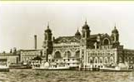
The Ellis Island website: www.ellisisland.org

Slide 16
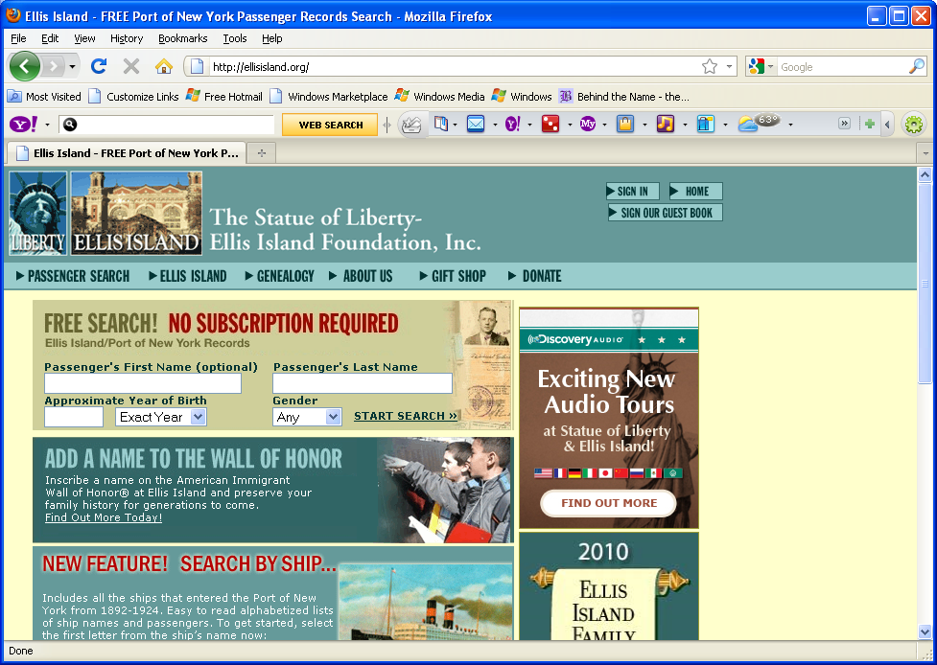

Slide 17
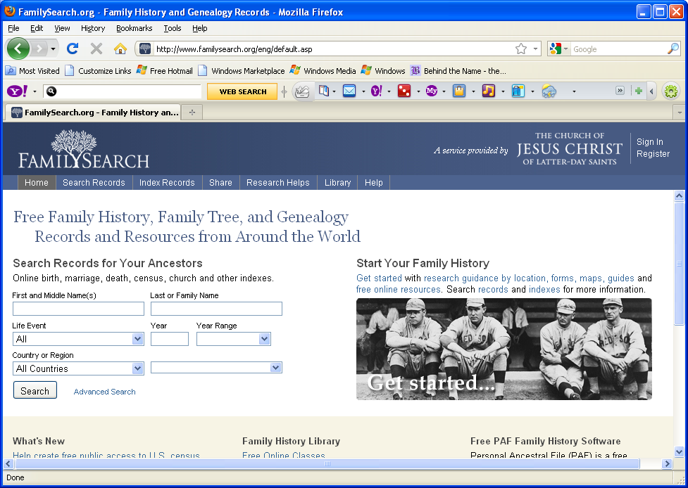

Slide 18
Stephen Morse’s site
Good ways to trace Ellis Island and other data
A good Soundex calculator

Slide 19
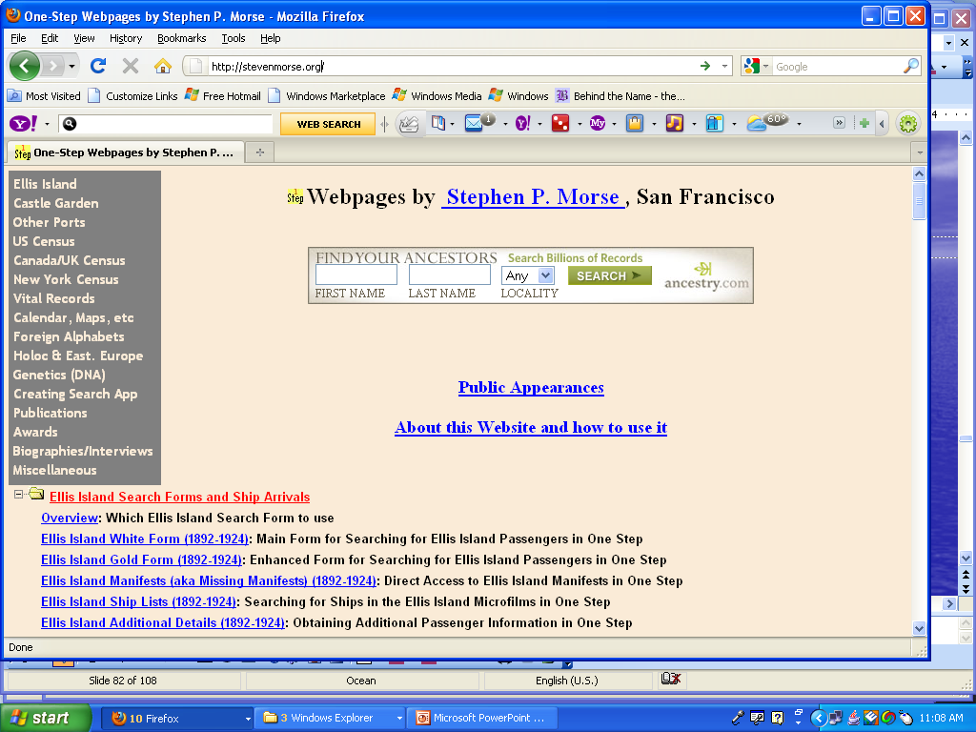

Slide 20
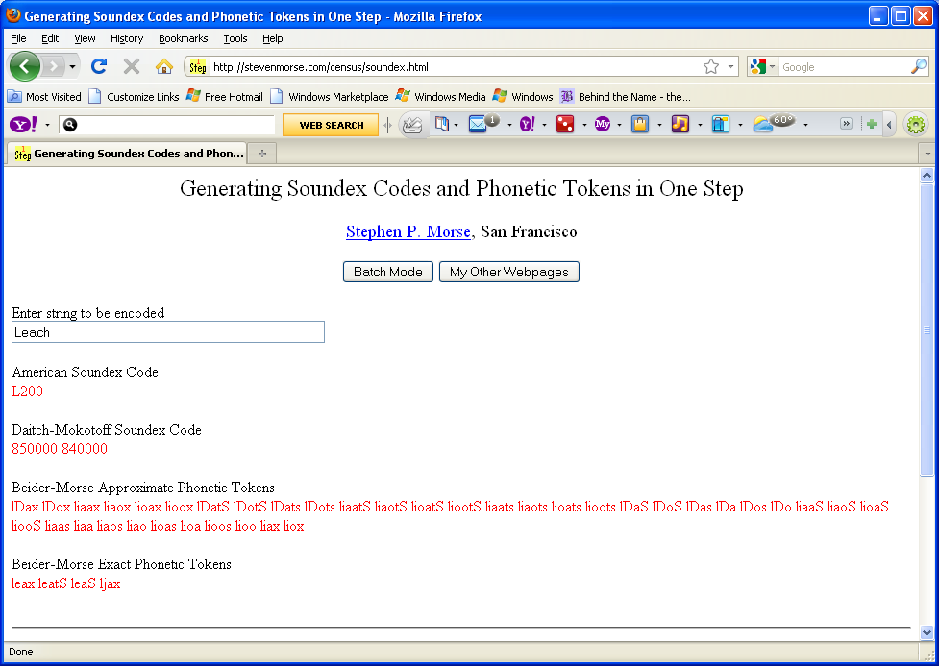

Slide 21
Internet records: Free sites, for now
Internet search engines
Local historical societies
Cyndislist.com
…

Slide 22
Problems
Not everything on the Internet is true.
  No one was married in an Ohio church in 1644.
  Having the surname “Holden” does not mean you are related to William Holden.
  Be wary of using information from people who argue about their results.

Slide 23
Especially important
Don’t assume information without sources is accurate.
Be wary of using data documented by “World Family Tree number xxx” or
“Ancestry World Tree number xxx”
This data may be like repeating a rumor – or it might be accurate

Slide 24
The index is important
You can’t search everything
Generally start with the indexes
Web sites have many – not all – of their pages indexed by search engines

Slide 25
Name spelling is inconsistent
Hard for immigration workers to get names correct
Worse for census takers and city directory
Shirecliffe – four different spellings in the same document!

Slide 26
One way to handle inconsistent spellings: Soundex
Match names to codes:
  Leach is encoded as L200
Intended to account for alternate spellings: Smith, Smythe, and Smyth
Imperfect, still most commonly used

Slide 27
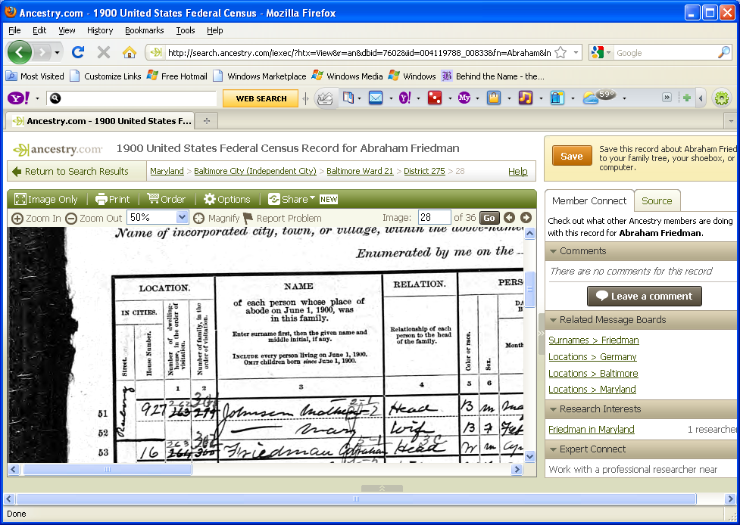
What’s the forename?

Slide 28
The forename originally indexed as Collaha, now also Abraham

Slide 29
Who does the indexing?
Volunteer genealogists and historians
Commercial transcribers

Slide 30
Searching is critical
Name variations
Wildcards
  Ander* matches Anderson, Andersen, and Anders
  Anders*n matches Anderson and Andersen
Misspellings
Soundex

Slide 31
Other local resources
Historical and genealogical societies
Family History Library
Both may have free access to ancestry.com

Slide 32
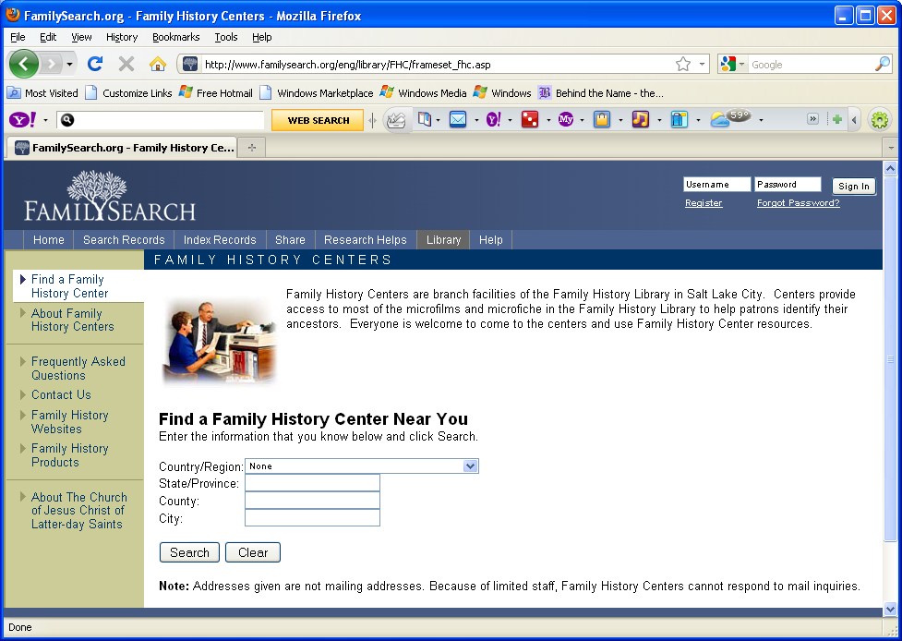

Slide 33
Commercial sites are available
ancestry.com
heritagequest.com

Slide 34
Summary
Free information is available at:
National Archives
familysearch.org
stephenmorse.org
rootsweb

Slide 35
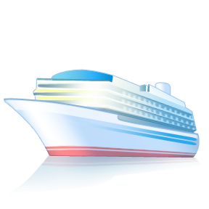

Slide 36
Thank You!

