Slide 1
Genealogy Without the Internet
Ronald J. Leach

Slide 2


Slide 3
Paper records
Where to find them
Nearly everything on the Internet is also available on paper
Most things available on paper are not on the Internet
cyndislist.com can help with addresses

Slide 4
Paper records
Vital records: birth, death, marriage
Census records – watch for spelling and poor indexing
  I found “Abraham” indexed as “Collaha”
Immigration records
Death, probate, land records

Slide 5
Mark Twain: I am my own grandfather
After long years as a bachelor I was tired of being alone and married a widow with a grown daughter.
My father fell in love with the daughter & took her as his wife.

Slide 6
Father
Mark Twain
Widow
Daughter

Slide 7
Father
Daughter
Mark Twain
Widow
This made me my own son-in-law and my stepdaughter became my mother.

Slide 8
Mark Twain’s grandfather
After a year my wife gave birth to a son.
Now, my son was my father's brother-in-law and at the same time my uncle, since he was my stepmother's brother.

Slide 9
Father
Daughter
Mark Twain
Widow
Son
My son was my father's brother-in-law and at the same time my uncle, since he was my stepmother's brother.

Slide 10
Mark Twain’s grandfather, cont.
But my father's wife also gave birth to a son.
So this was my brother and also my grandson, since he was the son of my daughter.
This meant I'd married my grandmother, since she was the mother of my mother.
As my wife's husband, I was also her grandson.
And since the husband of a grandmother is always a grandfather, I am my own grandfather.

Slide 11
Father
Daughter
Mark Twain
Widow
Son
Son

Slide 12
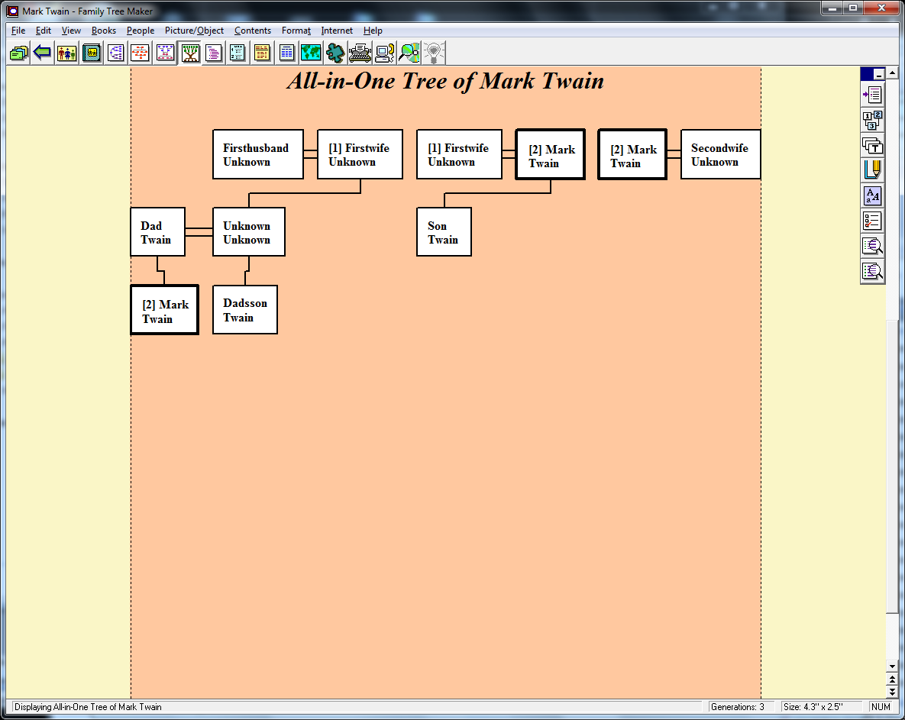

Slide 13
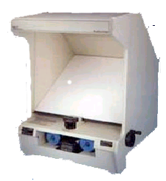
Microfilm

Slide 14
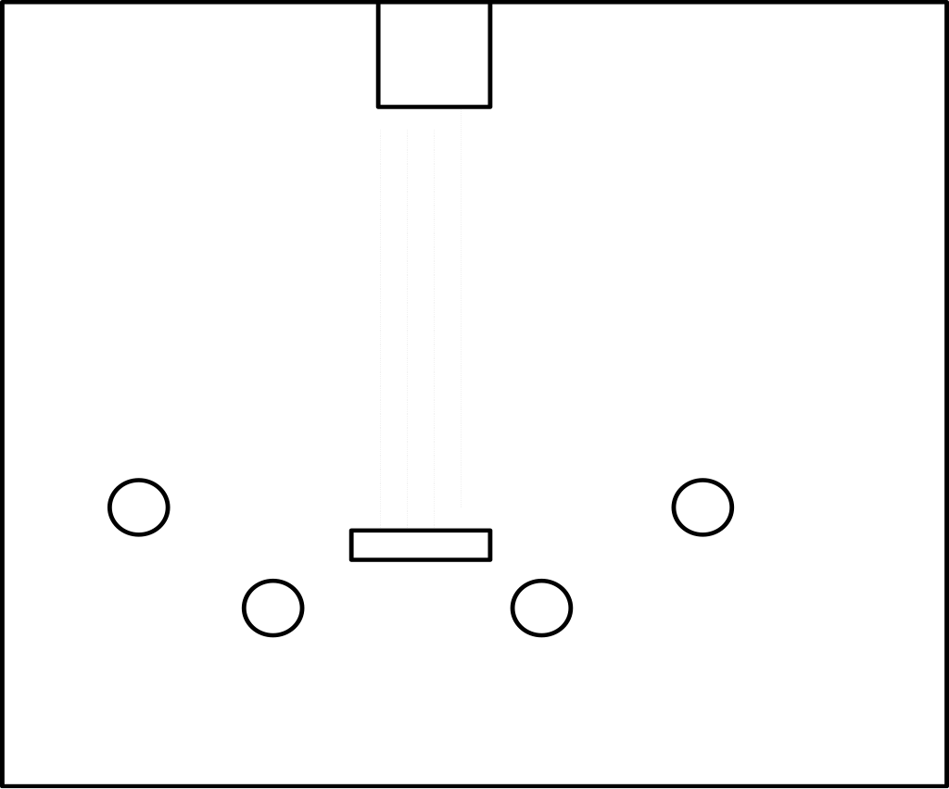

Slide 15
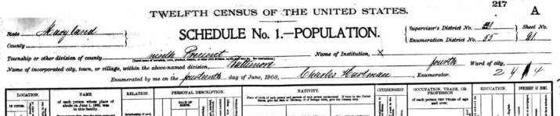
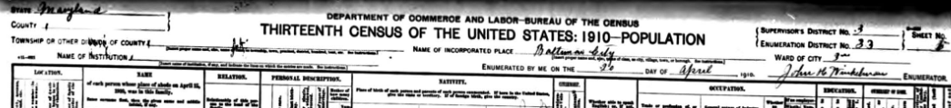


Slide 16
Some local resources
Public Libraries
Newspapers
State and local archives
Religious records
Public records
College and university libraries

Slide 17
Other local resources
Historical and genealogical societies
Family History Library
Both may have free access to ancestry.com

Slide 18
The index is important
You can’t search everything
Generally start with the indexes
Web sites have many – not all – of their pages indexed by search engines

Slide 19
Name spelling is inconsistent
Hard for immigration workers to get names correct
Worse for census takers and city directory
Shirecliffe – four different spellings in the same document!

Slide 20
One way to handle inconsistent spellings: Soundex
Match names to codes:
  Leach is encoded as L200
Intended to account for alternate spellings: Smith, Smythe, and Smyth
Imperfect, still most commonly used

Slide 21
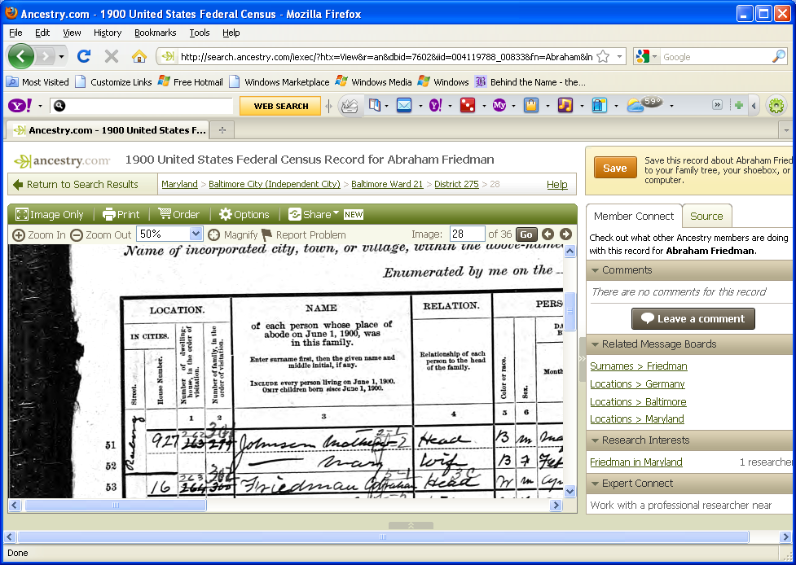
What’s the forename?

Slide 22
The forename originally indexed as Collaha, now also Abraham

Slide 23
Who does the indexing?
Volunteer genealogists and historians
Volunteer transcribers

Slide 24
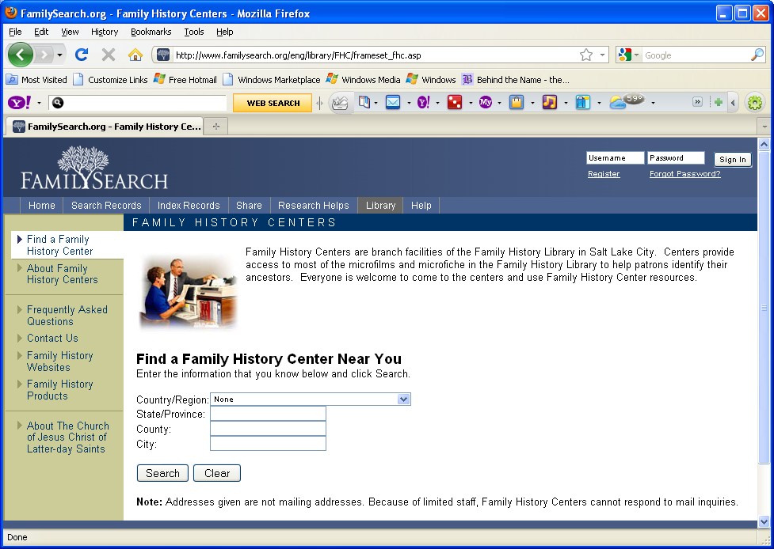

Slide 25

What is the upper case letter?

Slide 26
H seems to be the most likely.
K, squeeze vertical portions together.
N, two descending curves.
A, two parts that descend to the bottom.
The answer is:

Slide 27
H seems to be the most likely.
K, squeeze vertical portions together.
N, two descending curves.
A, two parts that descend to the bottom.
The answer is: A

Slide 28

Q ?
F ?
T ?
The answer is:

Slide 29
Q ?
F ?
T ?
The answer is: T

Slide 30


Slide 31
pend ck

Slide 32
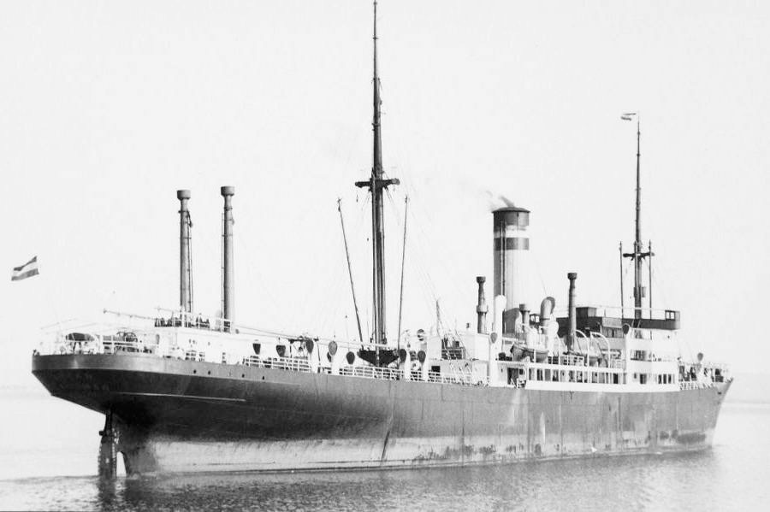

Slide 33
A little-known source
City directories
In my local public library!

Slide 34
Travel can be expensive
Plan your trip
Bring your materials
Cameras?

Slide 35
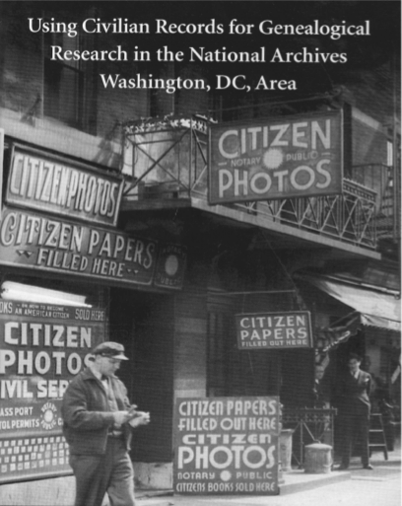

Slide 36
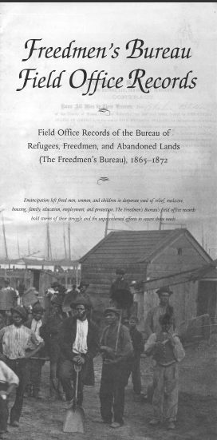

Slide 37
Organizing your records
Store them in files
Bring the files you need
Be careful of your computer

Slide 38
Organizing your records
Store them in files
Bring the files you need
Be careful of your computer

Slide 39
Organizing your records
Store them in files
Bring the files you need
Be careful of your computer

Slide 40
Organizing your records
Store them in files
Bring the files you need
Be careful of your computer

Slide 41
Organizing your records
Store them in files
Bring the files you need
Be careful of your computer

Slide 42
Organizing your records
Store them in files
Bring the files you need
Be careful of your computer

Slide 43
Have fun!

Slide 45
Thank You!

