Slide 1
Ocean Voyages before Steam
Ronald J. Leach

Slide 2
How to explore in the ocean
Have a raft or a boat
Wait for the currents
Avoid storms
Don’t hit a rock or a whale
Don’t fall in
Have enough water and food

Slide 3
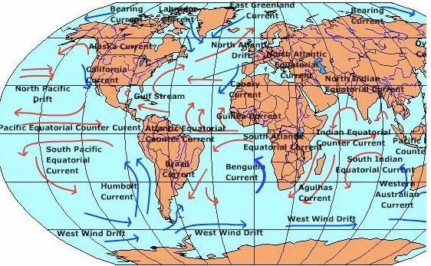
Source: www.uwsp.edu/geo/faculty/ritter
Notes:
Four types of current: water surface, wind, local, deep
Can simply drift on a raft or ship or you can use a fixed sail to catch the prevailing wind
Loius Zamperini floated with the currents - see the recent book Unbroken by Laura Hillenbrand
More on the wind later.

Slide 4
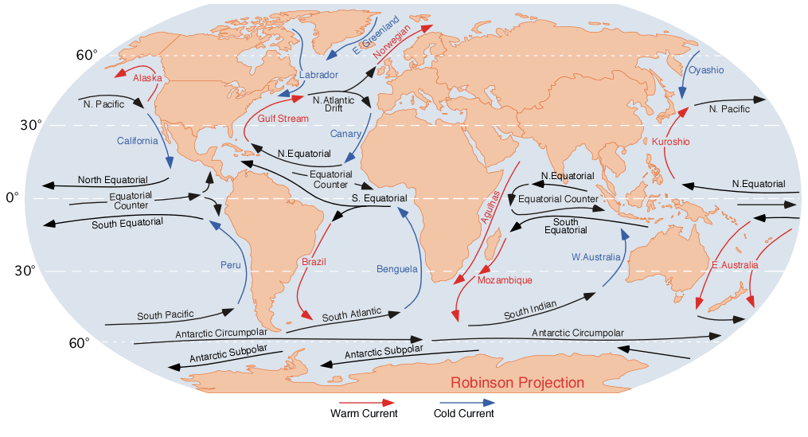
Source: Wikipedia

Slide 5
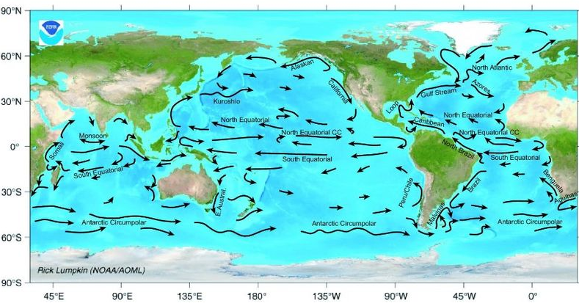
Major ocean surface currents
Source: NOAA
Notes:
Notice the current toward San Diego, California. A Carnival cruise ship had an engine fire in 2010 and was towed in by six tugs. This was much easier because of the current.

Slide 6
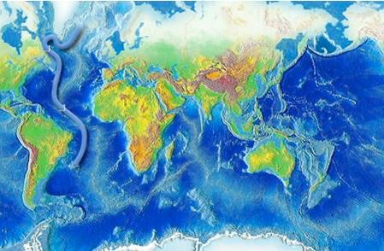
Source: http://oceanservice.noaa.gov/education/kits/currents/06conveyor1.html
Notes:
The conveyor belt.

Slide 7
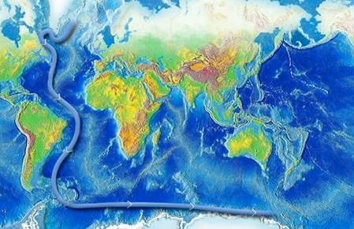

Slide 8
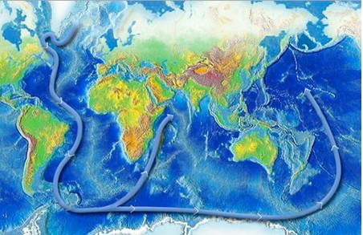

Slide 9
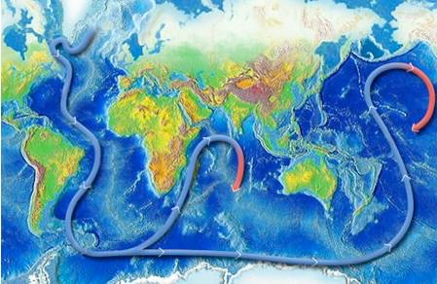

Slide 10
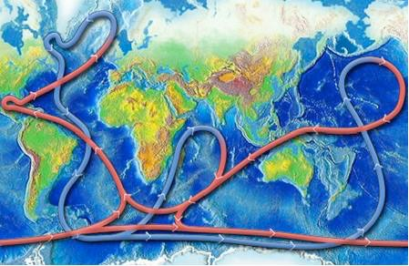

Slide 11
How to propel a simple watercraft
Current (raft)
Poles (in shallows, on rivers)
Oars
Sails

Slide 12
How to navigate
Stay in sight of land
Stars and sun
Maps and charts (later)

Slide 13
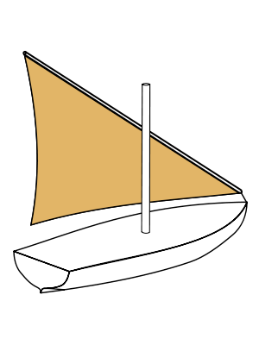
Text
Notes:
Lateen sail, allows tacking into the wind. Came from Arabia through the Eastern Mediterranean (hence Lateen, for Latin).
The time of first use in Europe is disputed, but certainly movable sails were on Spanish caravelles such as Columbus’ and other ships during the Age of Exploration. Similar sails were used in Polynesia.

Slide 14
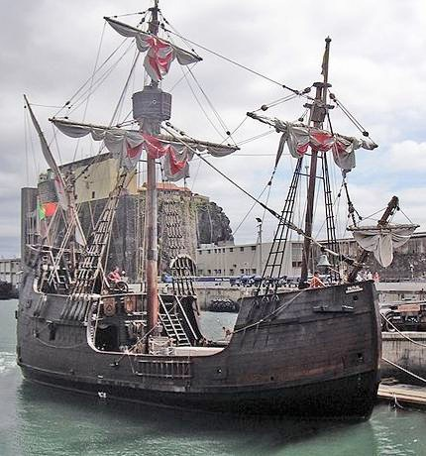
Santa Maria replica Source: Wikipedia

Slide 15
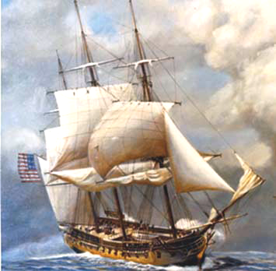
USS Constitution Source: wikipedia
Notes:
USS Constitution

Slide 16
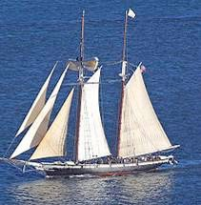
Notes:
Baltimore Clipper

Slide 17
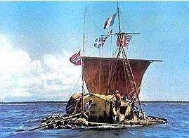
Kon-Tiki raft of Thor Heyerdahl

Slide 18
Major ocean surface currents
Source: NOAA

Slide 19
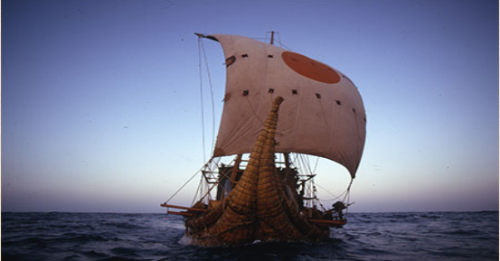
Ra-II, a Papyrus Boat

Slide 20
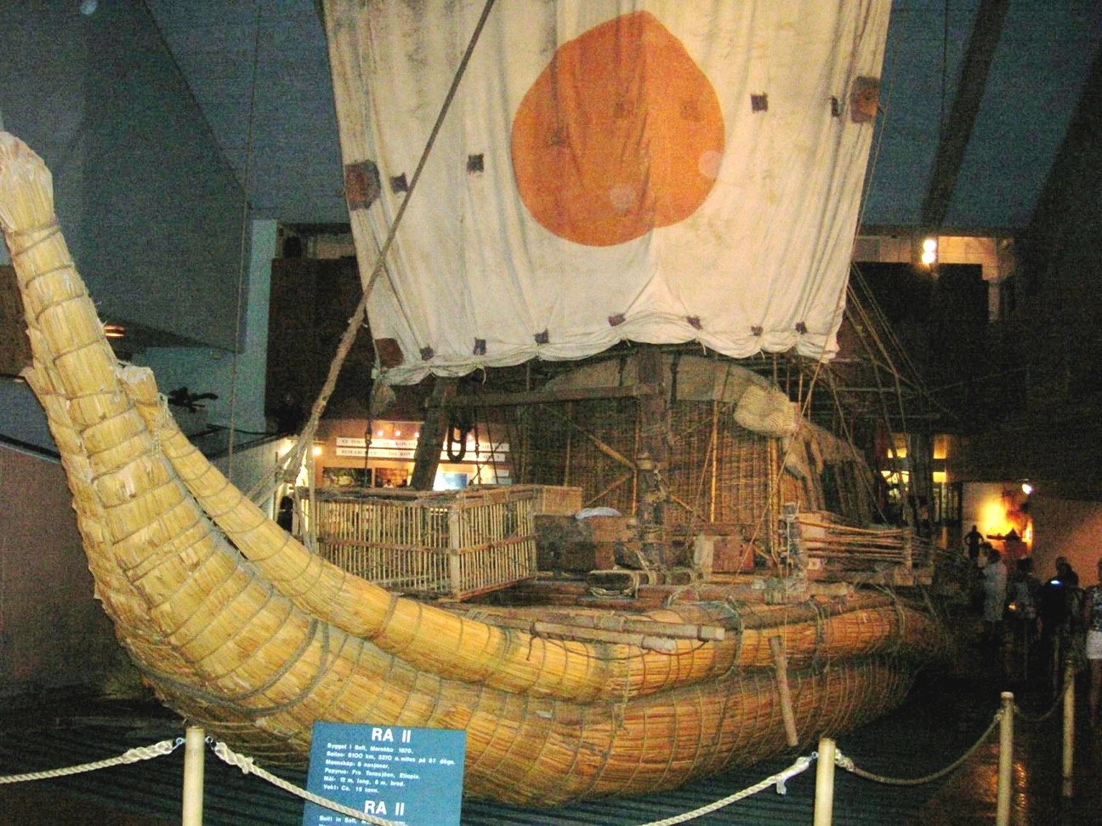

Slide 21
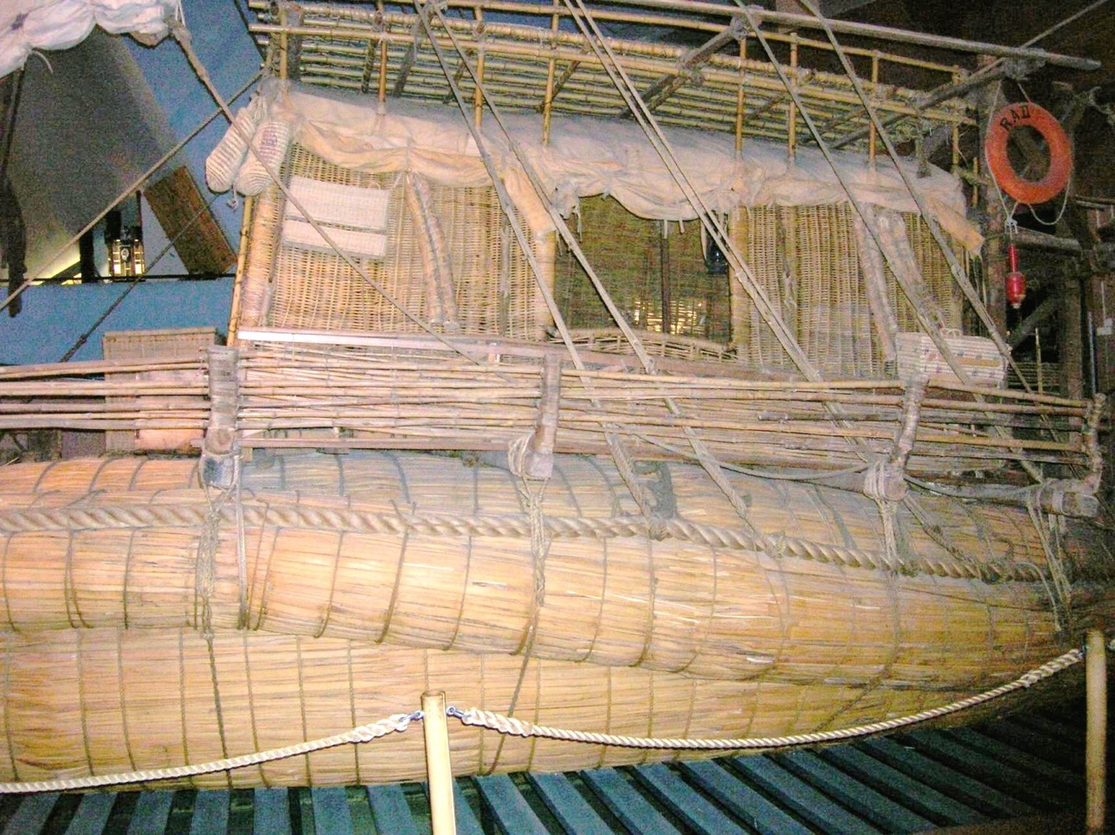

Slide 22
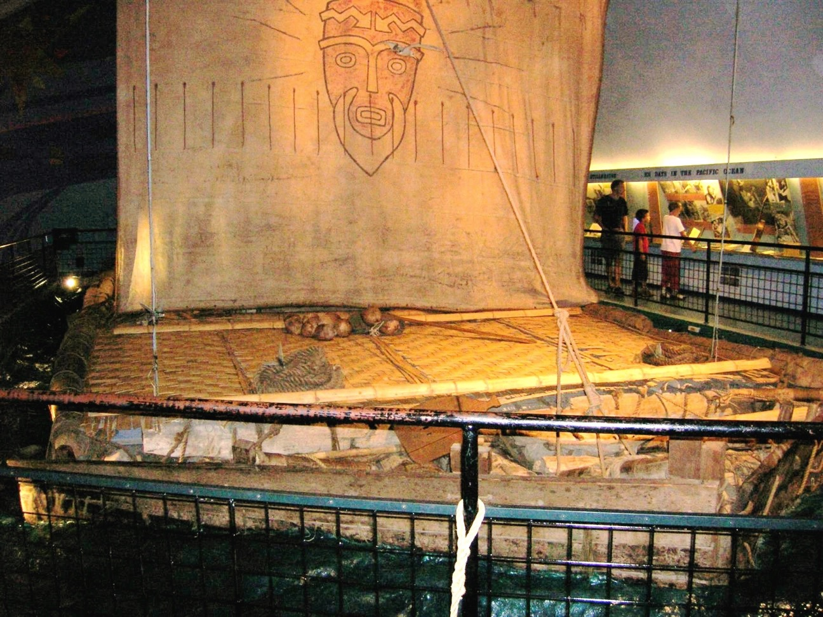

Slide 23
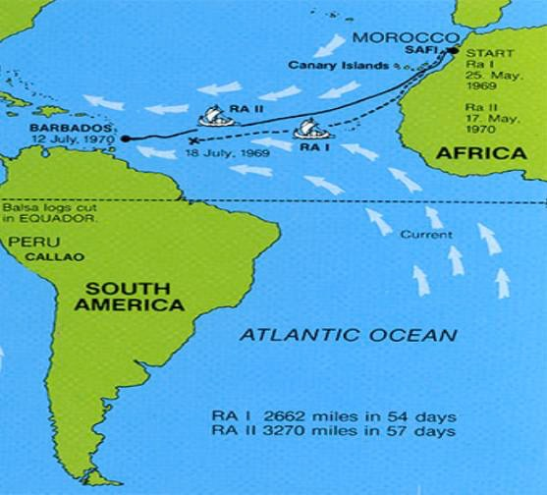

Slide 24
Columbus’ first voyage
August 3, 1492, Columbus sails to Canary Islands to restock and make repairs.
Leaves Canary Islands on September 6
Lands 37 days later in Bahamas on October 12, 1492

Slide 25
Columbus’ first voyage
August 3, 1492, Columbus sails to Canary Islands to restock and make repairs.
Leaves Canary Islands on September 6
Lands 37 days later in Bahamas on October 12, 1492
Total travel time (53 days)

Slide 26
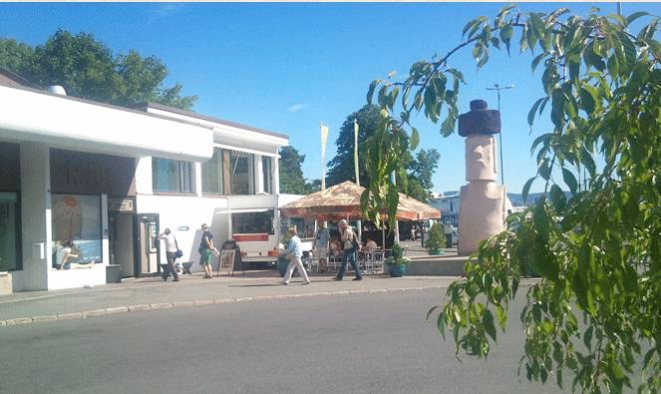

Slide 27
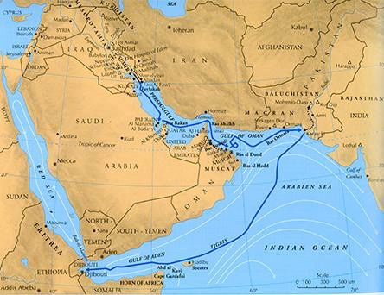
Heyerdahl’s 1978 Tigris expedition

Slide 28
What about the islands?
Hawaii
Fiji
Tahiti
Easter Island
Falkland Islands
St. Helena
…

Slide 29

Major ocean surface currents
Source: NOAA

Slide 30
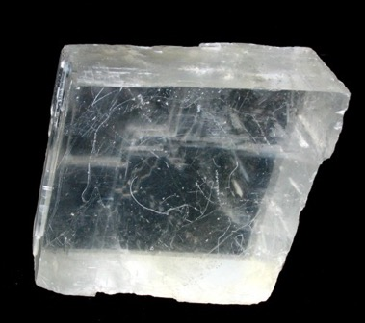
Leif Erickson
Left Greenland in 1002
Helluland ("Flat Stones Land"), Baffin Island ?
Markland ("Woodland"), Labrador ?
Vinland (Massachusetts), Newfoundland ?
Saga of the Greenlanders
Notes:
Icelandic spar is polarized - shows the direction of the sun even on cloudy days.

Slide 31
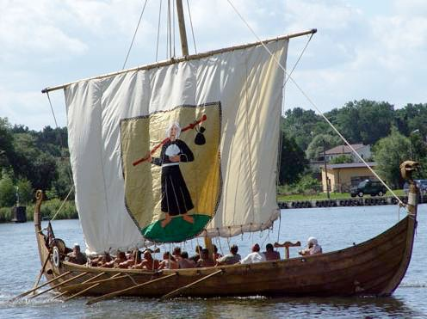
Source: Wikipedia

Slide 32
Major ocean surface currents
Source: NOAA

Slide 33
Major ocean surface currents
Source: NOAA

Slide 34
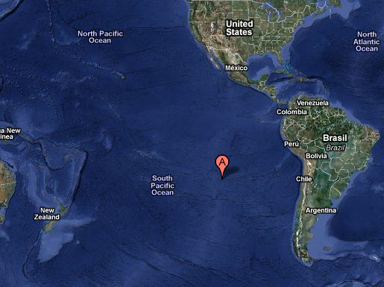

Slide 35
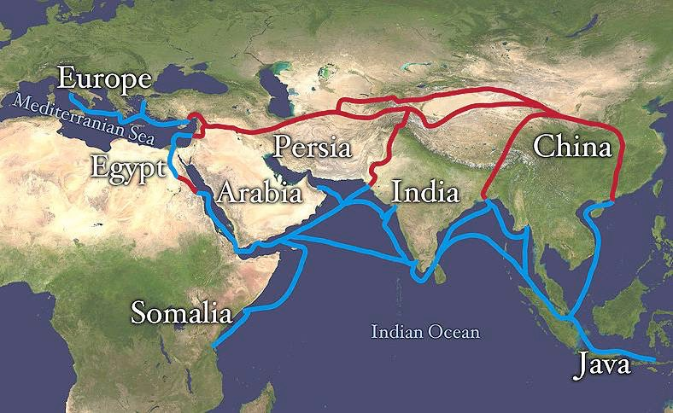

Slide 36
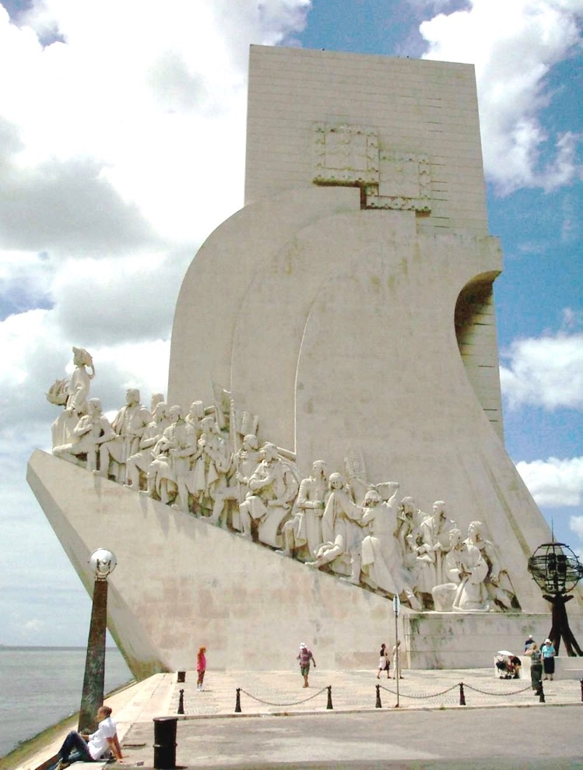

Slide 37
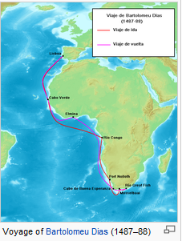
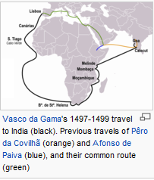
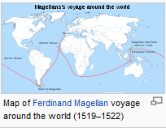
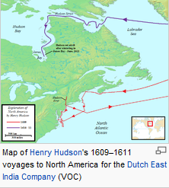
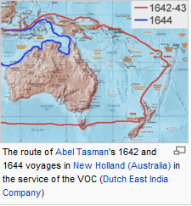

Slide 38
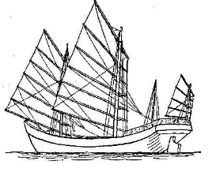
Marco Polo saw junks with 64 cabins and 300 crew
Notes:
Also had watertight chambers below. If the Titanic had them, the headline might have been “Titanic hit by Iceberg Limps into Port.”

Slide 39
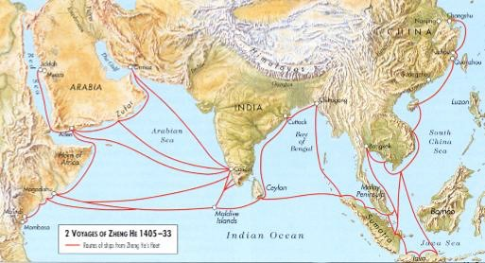
The Seven Voyages of Zhenge He
Courtesy: qed.princeton.edu

Slide 40
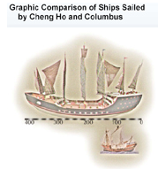
Courtesy UCLA International Institute

Slide 41
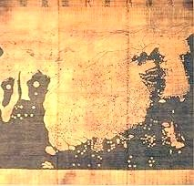
Kangnido map 1402 Source: Wikipedia

Slide 42
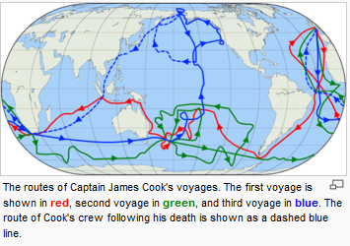

Slide 43
Perhaps Apocryphal Voyages
St. Brendan (512 to 530) voyage to “The Isle of the Blessed.”
  Many versions, with 14 to 60 pilgrims aboard.
Owain Madoc (1170) voyage from Wales to Mobile Bay, Alabama.

Slide 44
Exaggerated (?) Disputed(!)
The 1421 voyages of Zhenge He’s fleet to the Americas, Australia, Europe.
Gavin Menzies claims this in “1421: The Year China Discovered the World”
Sinclair (St. Clair) voyage from Scotland to New World around 1400

Slide 45
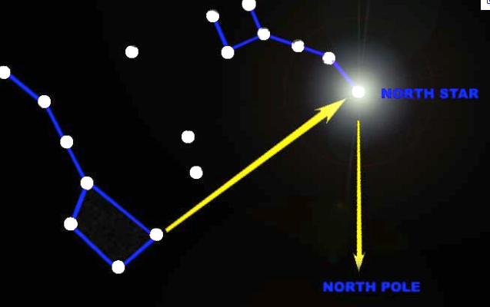
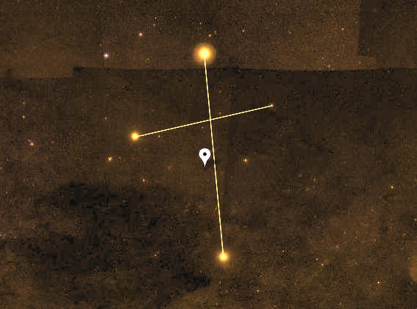

Slide 46
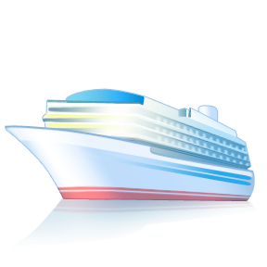

Slide 47
Thank You!

