Slide 1
Space – Some Inside Views
Ronald J. Leach

Slide 2


Slide 3


Slide 4
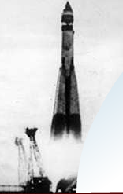
Sputnik – The Space Age

Slide 5
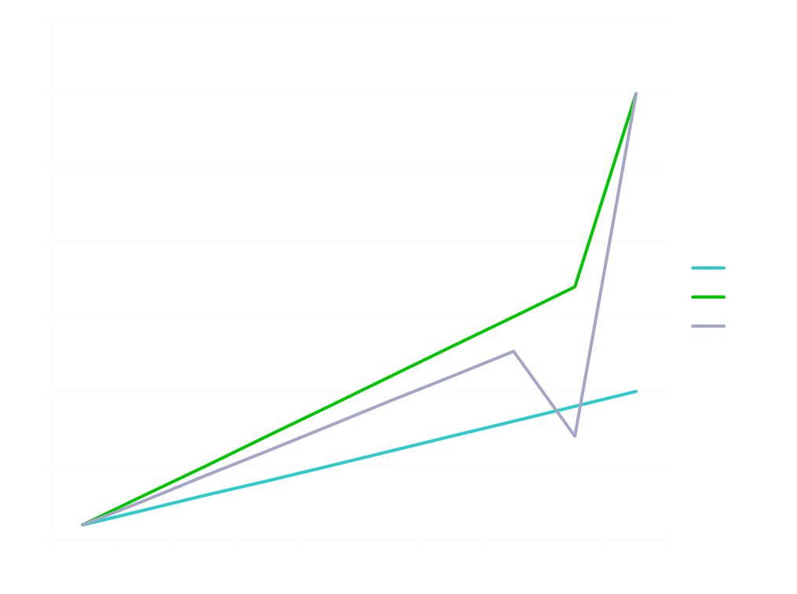

Slide 6
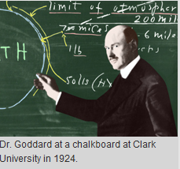
Robert Goddard
Explosion at WPI
Proved rockets work in vacuum
Liquid fuel rocket
Shot a scientific payload in a rocket
Multi-stage rocket
Rocket motor guidance

Slide 7
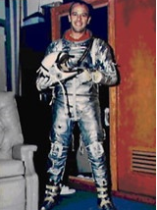
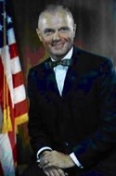
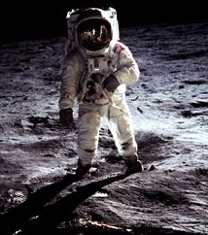
Who are they?

Slide 8
Who are they?

Slide 9
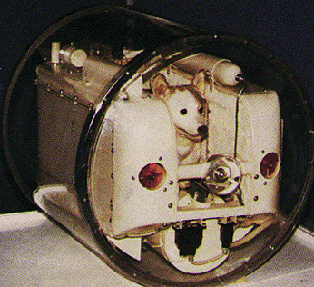
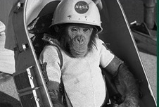
Who are they?

Slide 10
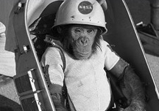

Who are they?

Slide 11
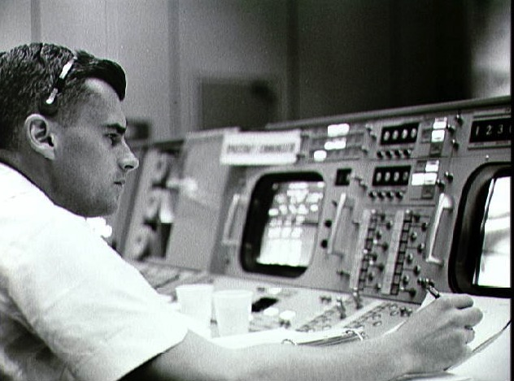
Astronaut Roger Chaffee at console during Gemini-Titan 3 flight

Slide 12
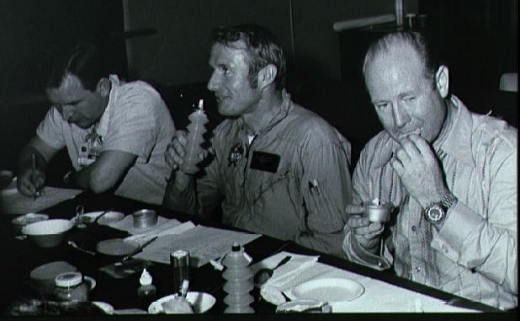
Apollo-Soyuz mission

Slide 13
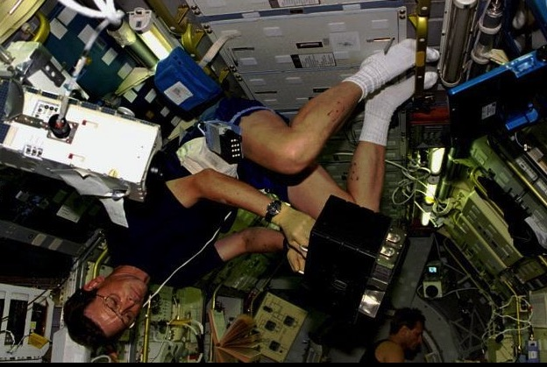
French Space Agency on Spacelab

Slide 14
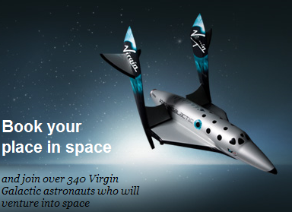
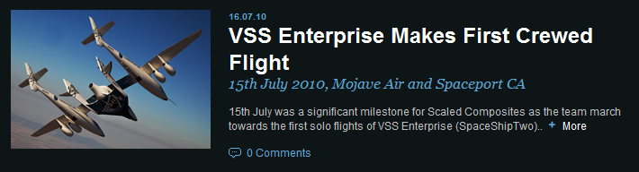

Slide 15
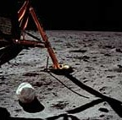

Slide 16
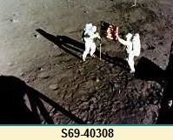

Slide 18
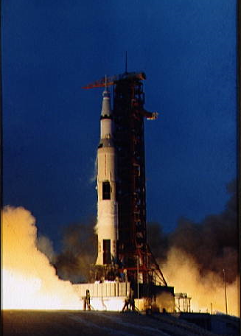
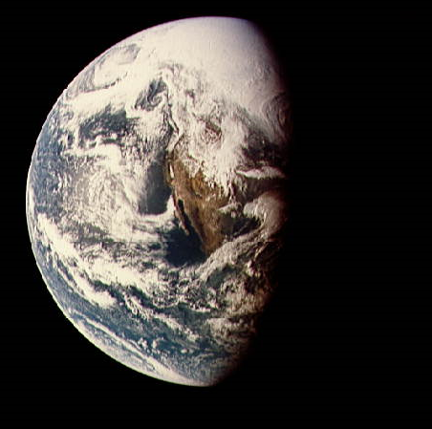
Apollo XIII

Slide 19
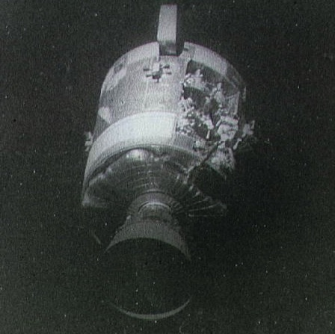
Apollo XIII

Slide 20
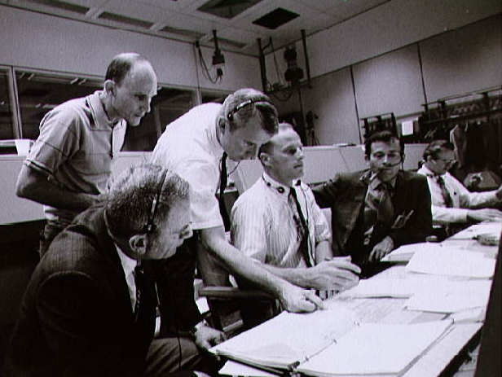
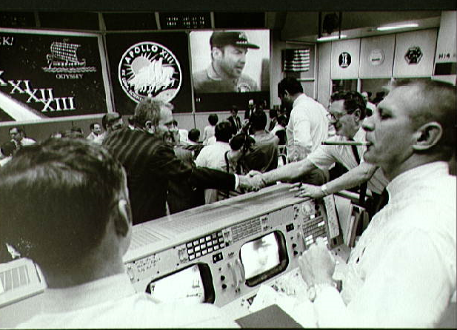

Slide 21
Other Successes
IMP-8
COBE
SMEX, …
Mars Rover

Slide 22
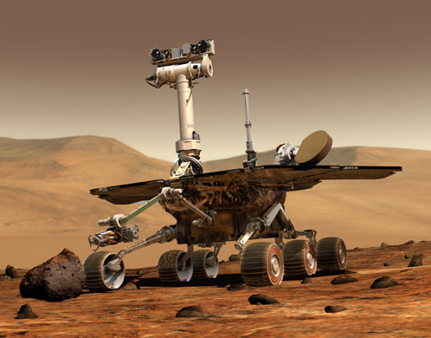
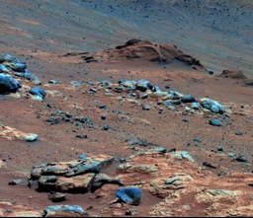

Slide 23
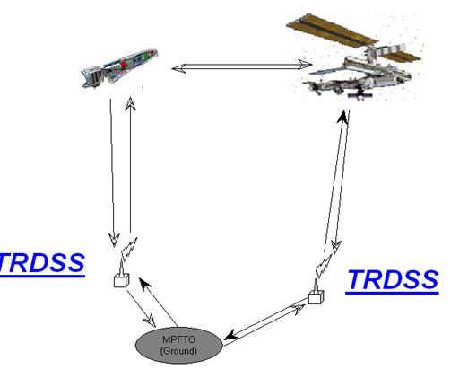
The International Space Station

Slide 24
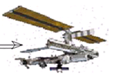
Approach and dock

Slide 25
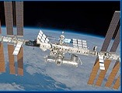
Approach Ellipsoid, Keep Out Sphere

Slide 26
The Can-Do Attitude
Major Innovations
Complex systems
Safety-critical
Long lead time

Slide 27
Is quality a problem?

Slide 28
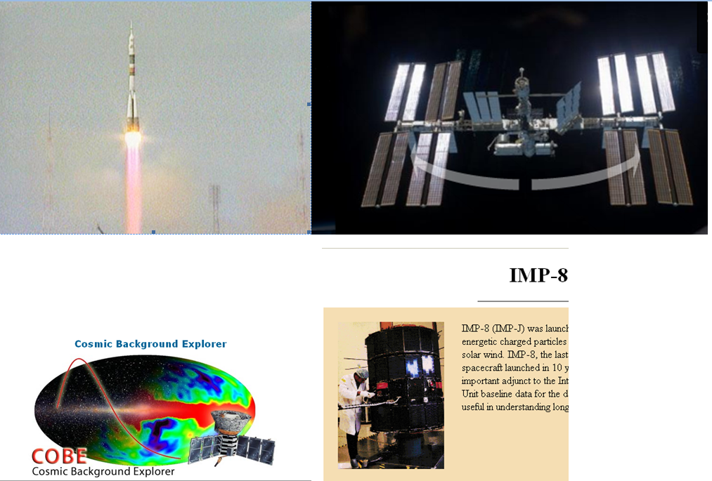
Is quality a problem?

Slide 29
Is Too Much Quality a problem?
Safety is preeminent
Does it stifle innovation?
Is it too expensive?
What about competition?

Slide 30
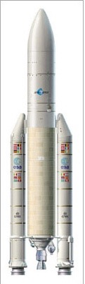
Ariane-5

Slide 31
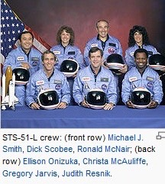

Slide 32
Industry
More!
Better!
Cheaper!
Faster!

Slide 33
Astronaut Roger Chaffee at console during Gemini-Titan 3 flight

Slide 34


Security

Slide 35


Slide 36
Thank You

