Slide 1
The Cars of Cuba
Ronald J. Leach

Slide 2
About Ron Leach
About me
My lectures aboard
Questions while you are on board
Notes:
Professor 41 years, 16 in math, 25 in Cs, including 9 as department chair. Retired: amateur genealogist, editor, cruise lecturer, accredit visits for CS programs. Always wanted to be a historian. Cruise lecturer is probably as close as I can get. Didn’t really have the engineer’s tinkering culture

Slide 3
My research relevant to this talk
Finding faults in complex software systems
Efficiently prevent, remove, mitigate them
Especially safety-critical systems like cars
Nearly all cars (low-end to luxury) have bad interactions with driving and entertainment systems
Notes:
It gets worse – when Apple Play or Android updates software new problems occur. Bluetooth is not a secure communications system

Slide 4
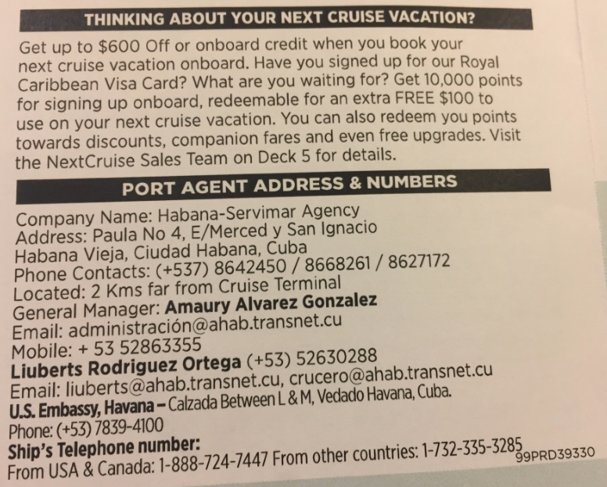
Arrival in Havana
Notes:
Take a picture identifying the port – so you can organize your pictures.

Slide 5
Outline of Presentation
Problems with Cars in Cuba
1950s Cars and Older
What are Classic Taxis Like?
Newer Cars
Commercial Transportation
Notes:
Cuba is a land of surprises. Little of what you have heard is completely accurate. Thrill and Chill

Slide 6
Problems with Cars in Cuba
Notes:
Hard to get parts, especially on older American cars

Slide 7
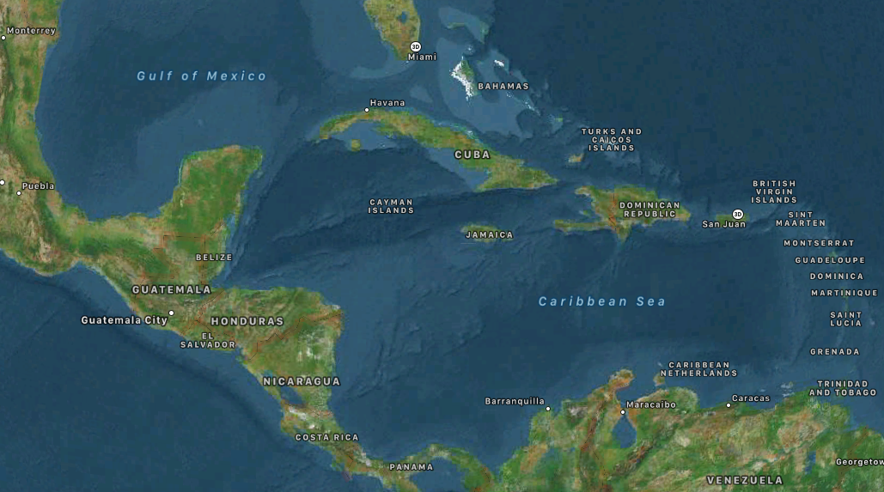
Cuba is in the Caribbean
Notes:
Cuba is in the Caribbean. Not Arizona !

Slide 8
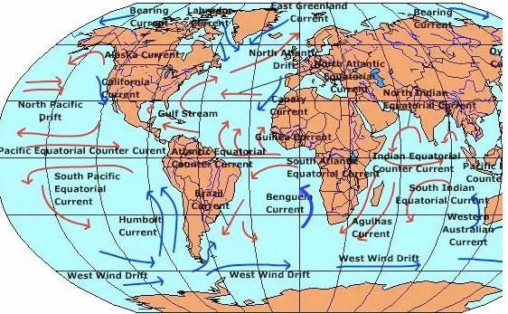
Currents: surface, wind, local, deep
Source: www.uwsp.edu/geo/faculty/ritter
Notes:
Lots of winds. And even worse, hurricanes. Driving winds in hurricanes can flood cars from both above and below.

Slide 9
Cuban Weather
Hot (subtropical)
Lots of ocean breezes, so salt water in the air
Humid
Frequent Rains
Hurricanes
So …
Notes:
Many cars not in garages, Tarps are useless in high winds or hurricanes. Seinfeld routine on a mattress tied to the roof of a car, holding it with his left hand out the window. I got it ! I got it !

Slide 10
Cuban Weather
Hot (subtropical)
Lots of ocean breezes, so salt water in the air
Humid
Frequent Rains
So …
Rust (but not as much as in areas where the roads get salted)

Slide 11
A Major Problem
New cars, trucks, and buses need to be imported (from where?)
Older cars need to be repaired
Notes:
Imported FROM COUNTRIES THAT TRADE WITH CUBA Repairs – think of the US hot rod culture

Slide 12
1950s Cars and Older
US cars were big!
Fins
Big, pointy headlights
Hood ornaments
Lots of chrome
Protruding mirrors
…

Slide 13
Older cars were easier to fix
Lots of room under hood
Didn’t need a lot of tools
Lots of ground clearance
Often didn’t need a lift

Slide 14
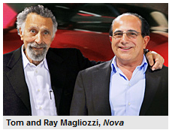
There was a car culture
Notes:
Almost everybody knew an amateur car repair expert. Carl Reeder. I can fix this car for $500

Slide 15
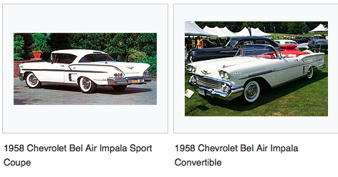
US cars in the late 1950s
Notes:
These are Chevys. Fins, chrome, headlights, ornaments. Other GM models had similar features

Slide 16
Major GM brands in the 50s
Chevrolet
Pontiac
Oldsmobile
Buick
Cadillac
Notes:
Why so many brands? To cover the market.

Slide 17
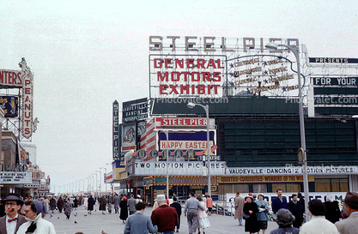

Slide 18
Ford Brands
Ford
Mercury
Lincoln

Slide 19
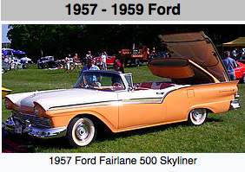
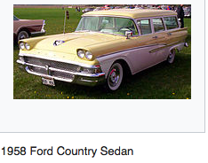
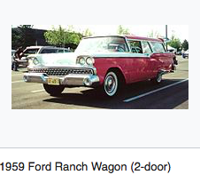
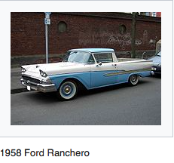
Notes:
Hardtop convertible, sedan, sporty truck, station wagon

Slide 20
Ford Brands
Ford
Mercury
Lincoln
and …

Slide 21
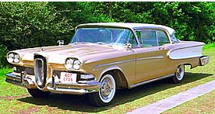
The Edsel

Slide 22
Chrysler Brands
Plymouth
Dodge
DeSoto
Chrysler

Slide 23
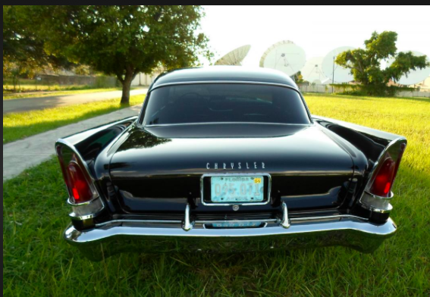
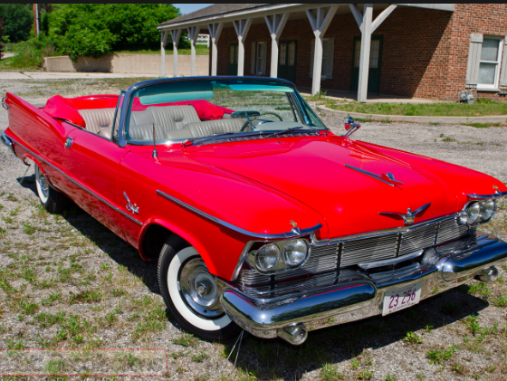
Chrysler New Yorker, Imperial Crown convertible

Slide 24
American Motors
Nash Metropolitan
Rambler American
Notes:
George Romney was the president of AMC.

Slide 25
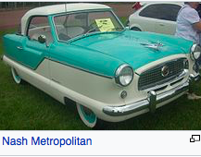
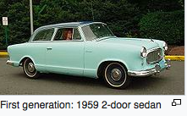
Notes:
Article on what cars to buy. “No one who is not married should buy a Rambler American.” I had one before I got married.

Slide 26
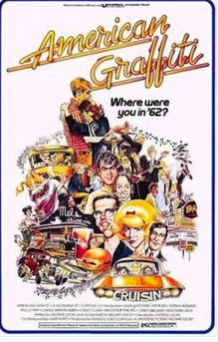

The Hot Rod Culture
Notes:
Love American Style segment, ABC rejects show. Lucas film a hit. Happy Days runs for 10 years

Slide 27
Hard to work on cars at home
Electronics are modular, specialized testing is needed
Computers require test equipment and complex software knowledge
No room under hood!!
Low clearance on many cars
Notes:
Headlights in Honda

Slide 28
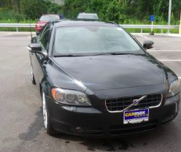
An example 1957 vs. 2011
Notes:
Two hardtop convertibles. Volvo C70 battery kept getting drained. Sirius FM Need for software update hard to detect. Nearly all manufacturers have unwanted interaction with entertainment systems.

Slide 29
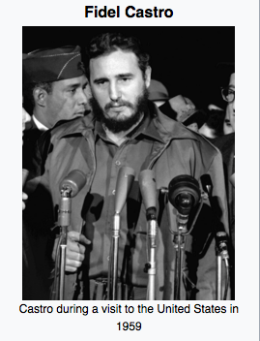
What happened in 1958?

Slide 30
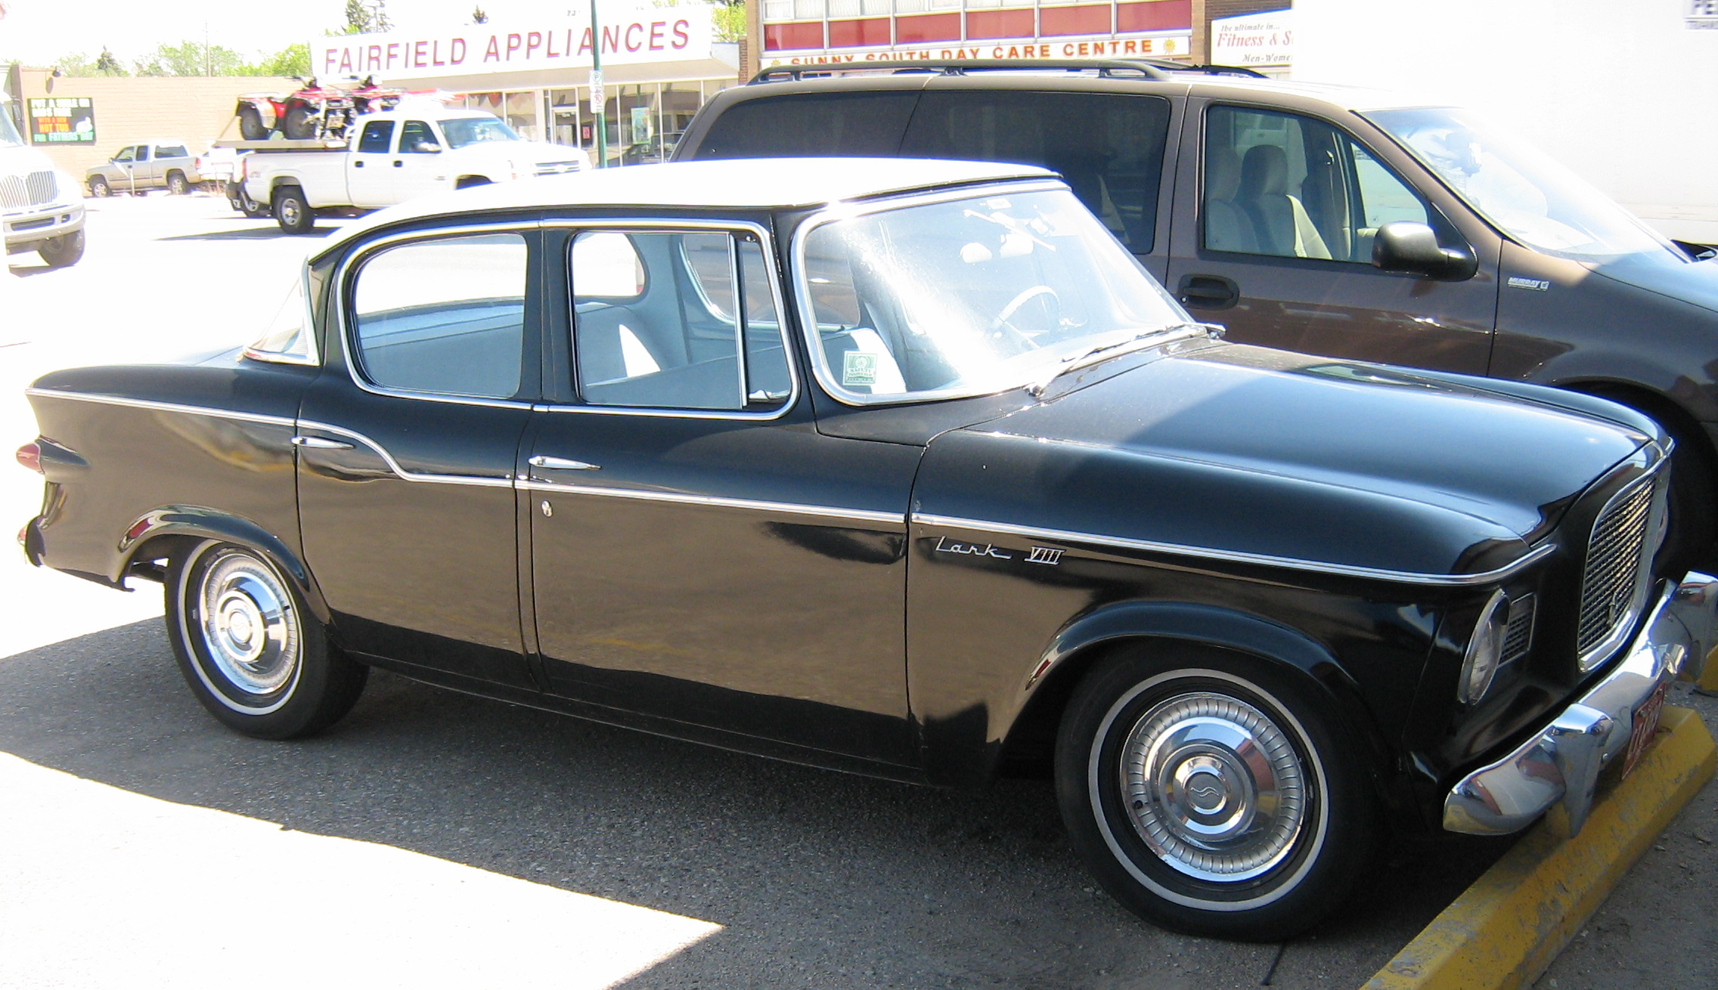
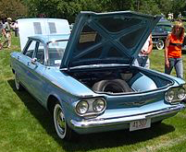
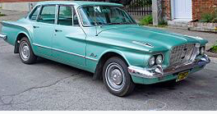
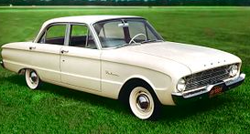
What happened in 1960?
Notes:
Studebaker Lark Chevrolet Corvair Ford Falcon Plymouth Valiant

Slide 31
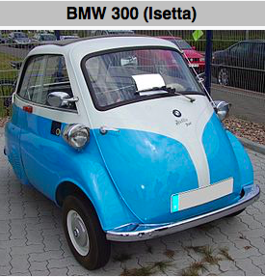
Would you want one of these?
Notes:
How do you get in?

Slide 32
Would you want one of these?
Notes:
Three guys going bowling. One with a bowling ball. No bowling lanes on campus then

Slide 33
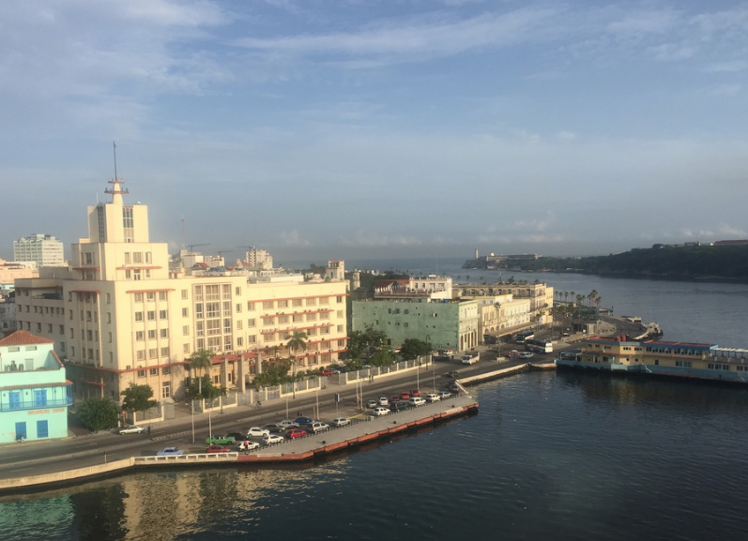
First Impressions
Notes:
Notice: lots of newer cars, modern bus, school bus

Slide 34
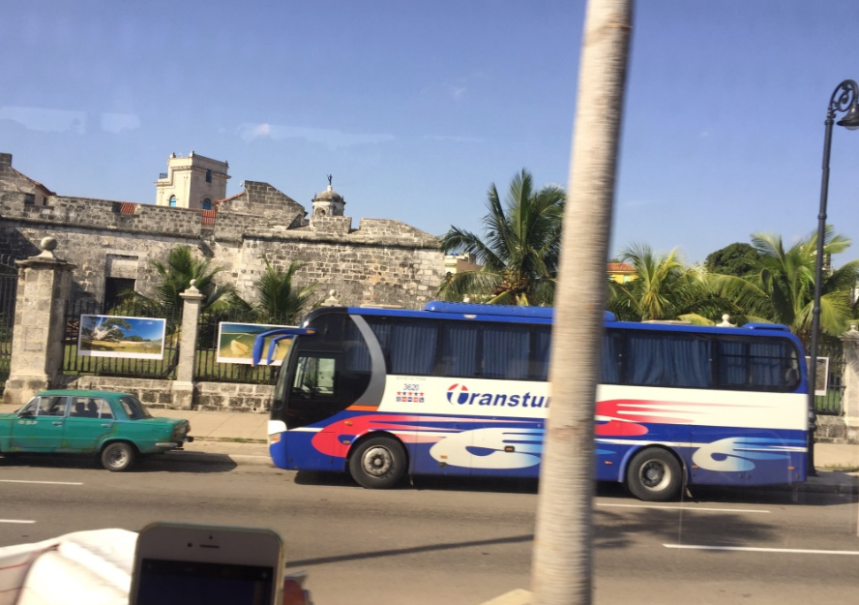
Not Old !
Notes:
Modern, comfortable Chinese bus

Slide 35
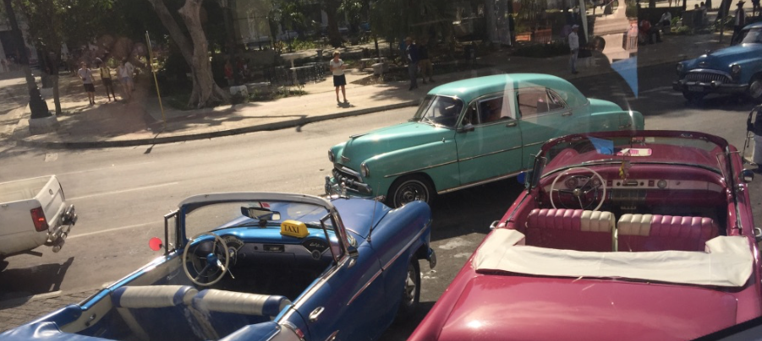
Old! But notice the modern truck

Slide 36
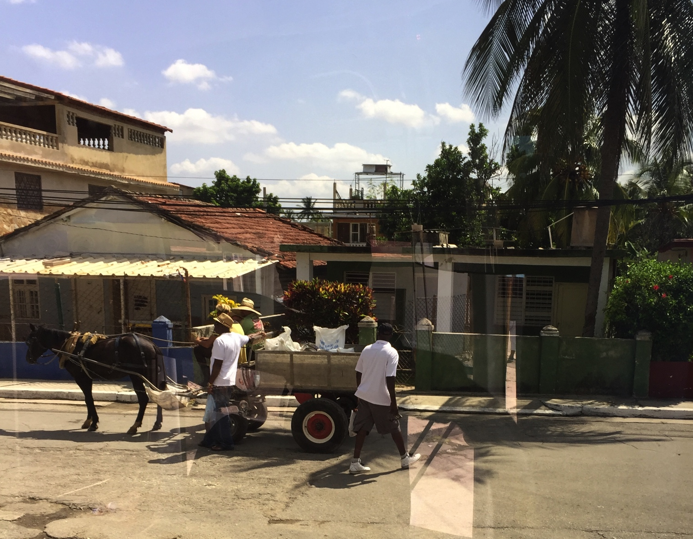
Older Technology!

Slide 37
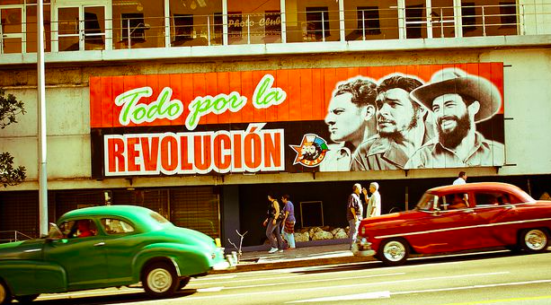
Cuba – What We Expect
Notes:
Notice how nice the cars look

Slide 38
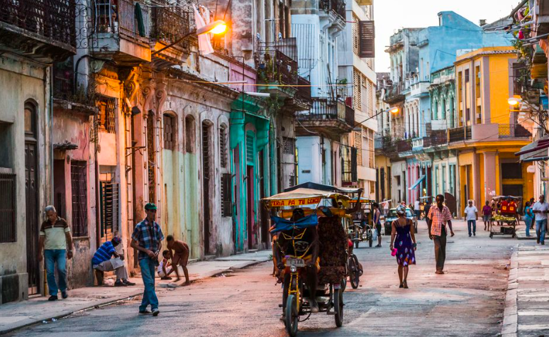
Cuba – What We Expect
Notes:
Havana low-tech tranportation

Slide 39
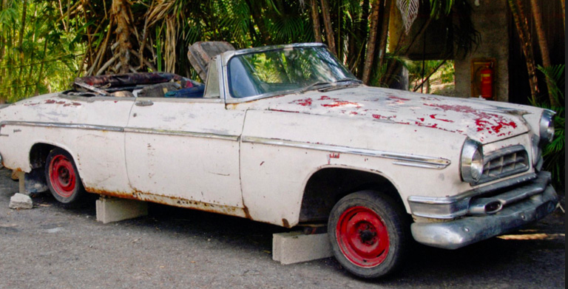
One of Hemingway’s Cars
Notes:
Ernest Hemingway loved Cuba

Slide 40
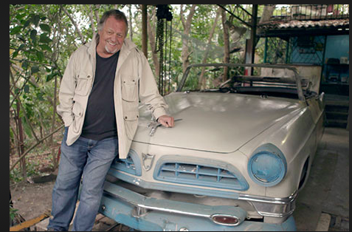
A Hemingway Car Restored
Notes:
Notice the hood ornament

Slide 41
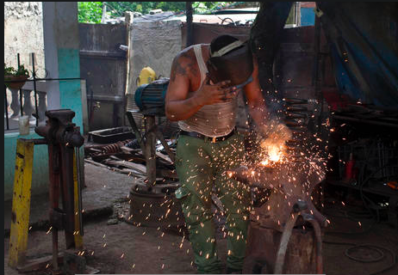
Cars need repair!
CBS New photo Oct 2014 (Coil Spring)

Slide 42
Car parts and repairs
Sheet metal – easy to find and manipulate
Springs – can manufacture
Tires – patch, repair, buy
Motors – any motor that fits
Think of the hot rod culture in the US (nostalgia!)
Notes:
Bondo
I remember seeing a VW beetle with a Corvette engine. Big at drag races.
A fellow student had a VW beetle that turned over. Had the top cut off, new doors installed, had a convertible top put on instead.

Slide 43
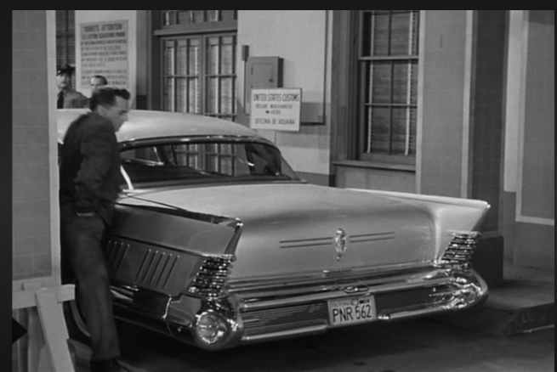
Desi Arnaz’ Car at Customs

Slide 44
What are Classic Taxis Like?

Slide 45
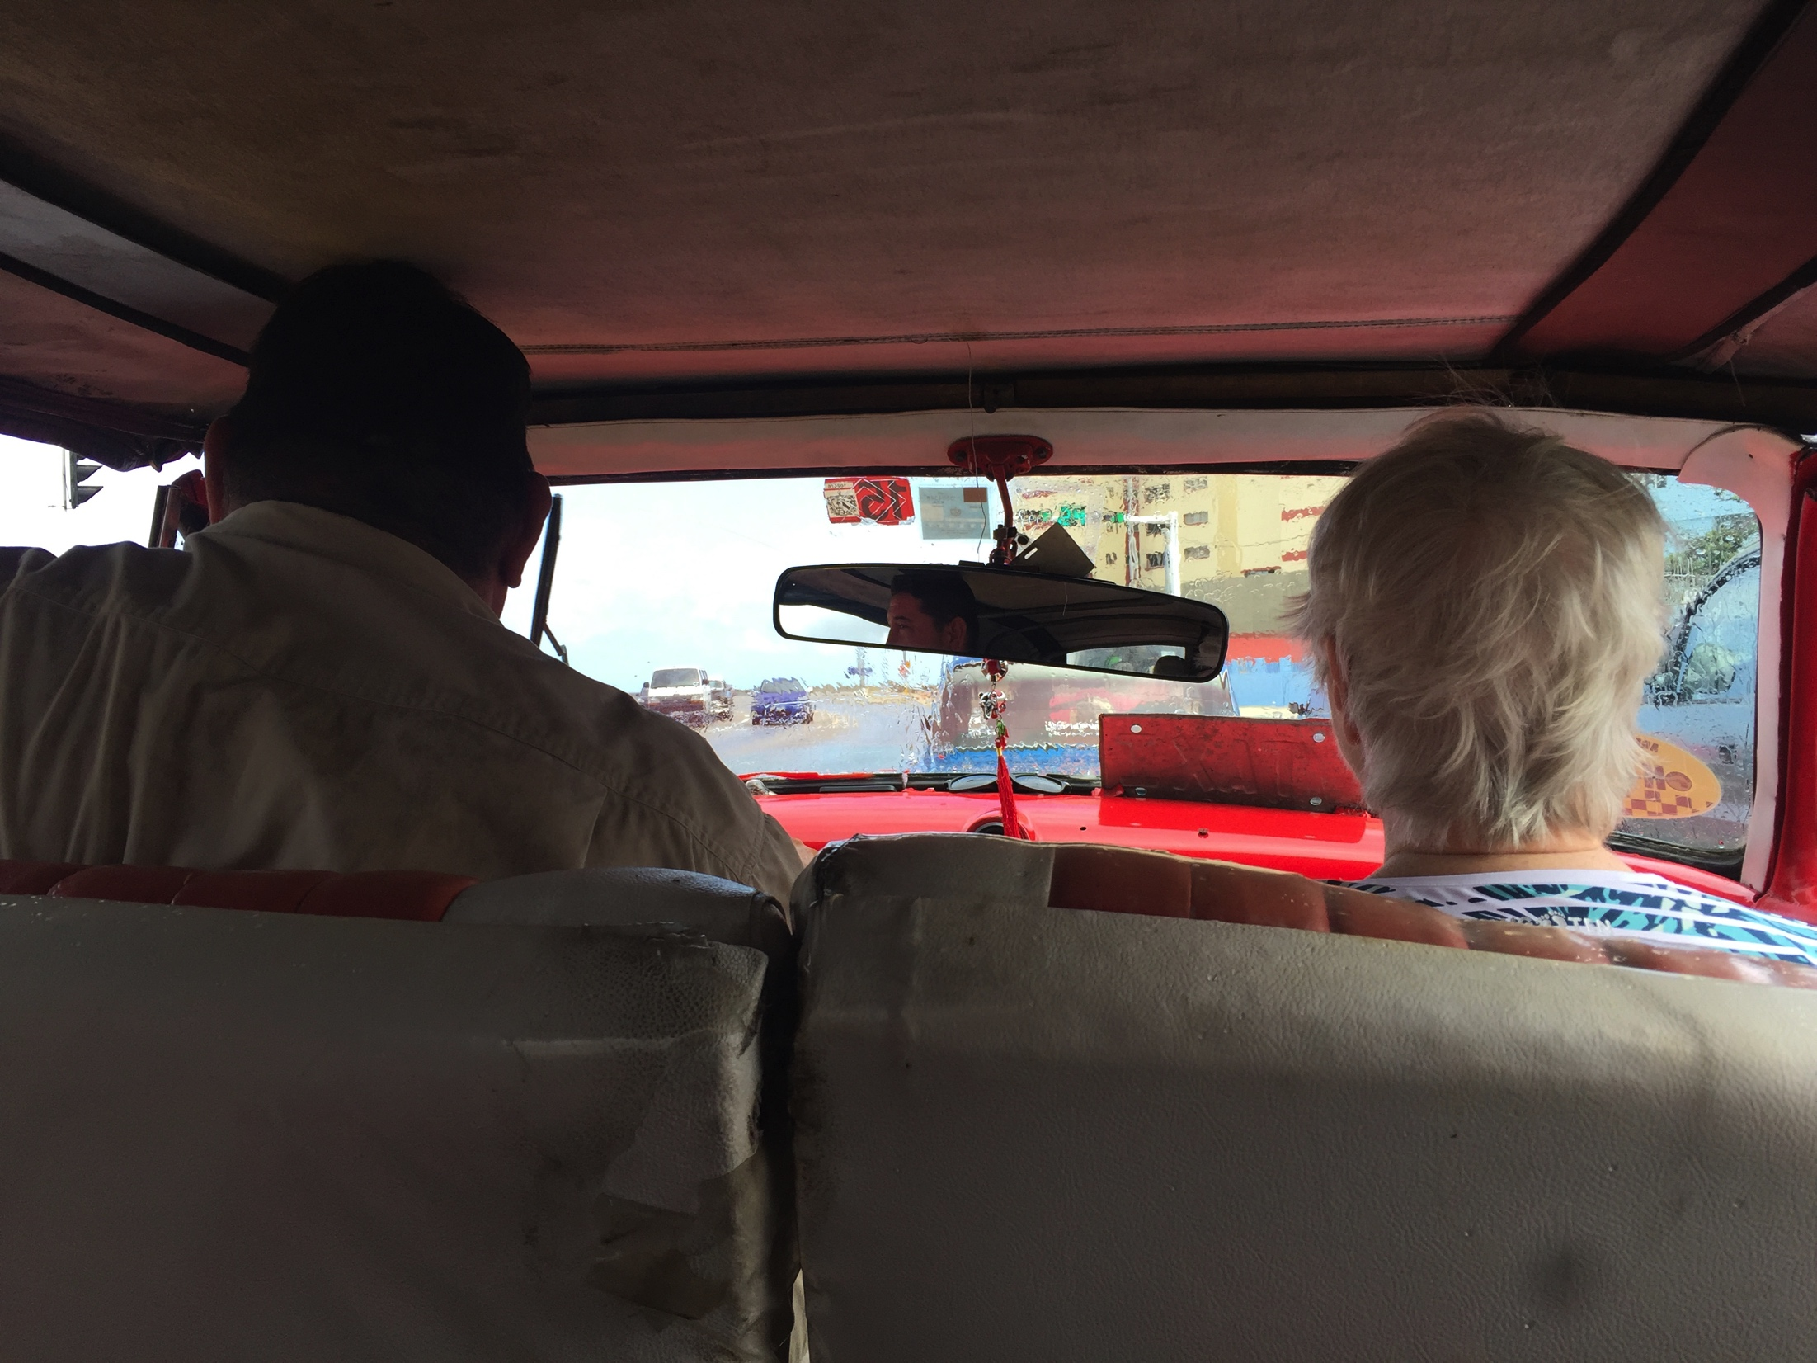
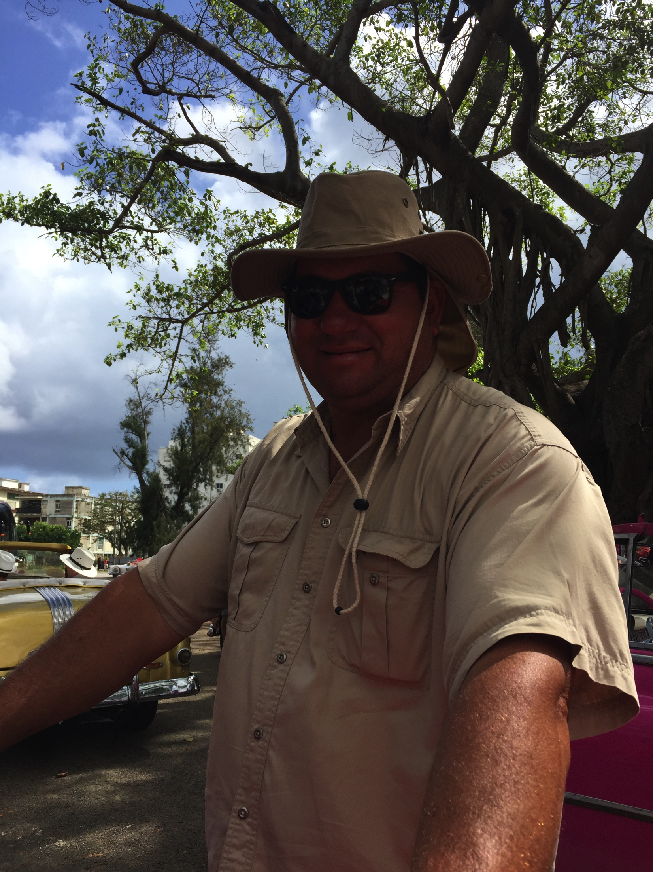

Slide 46
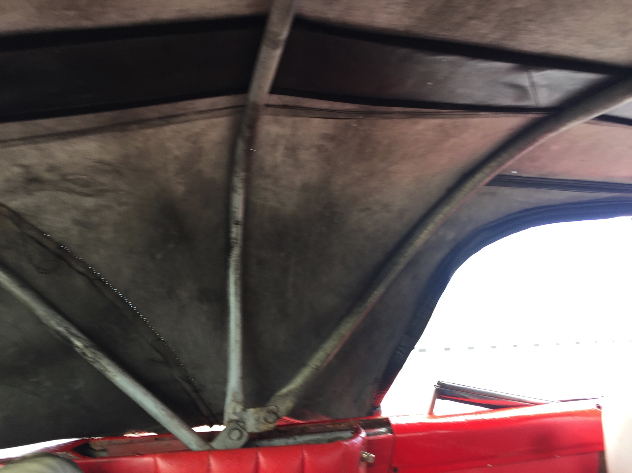
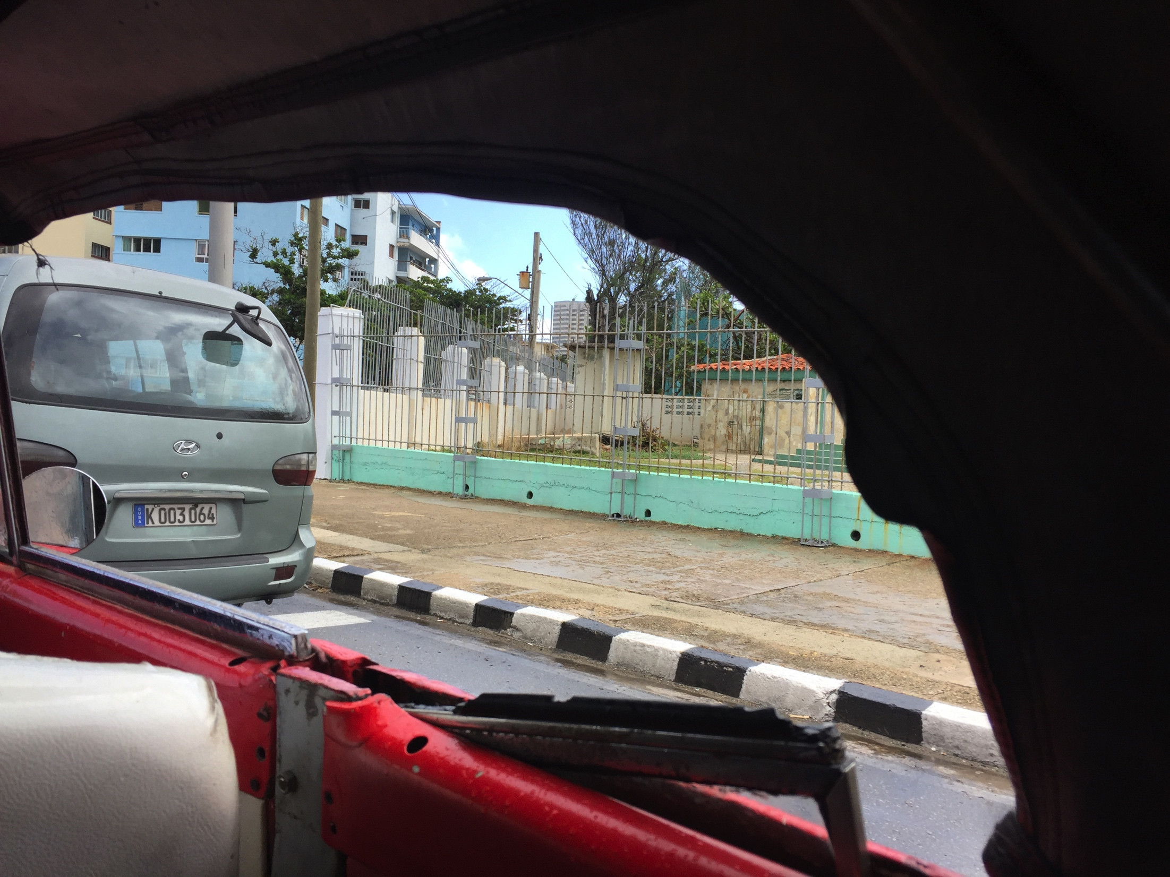

Slide 47
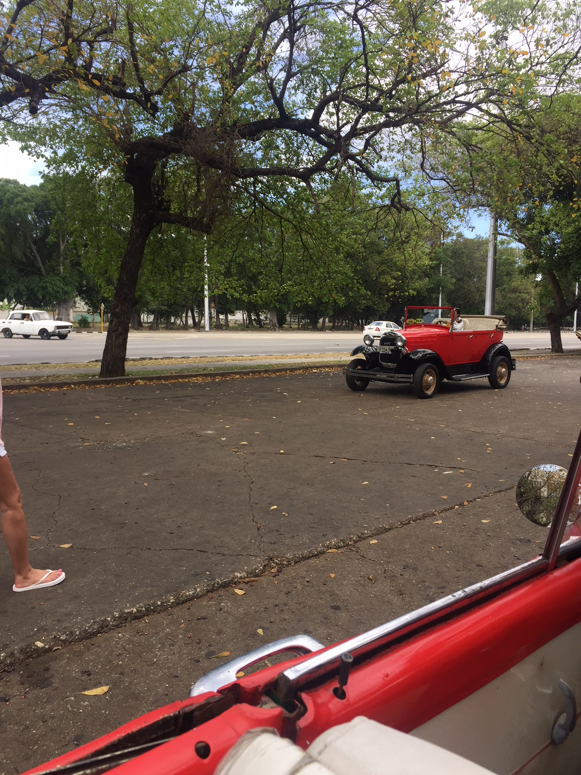
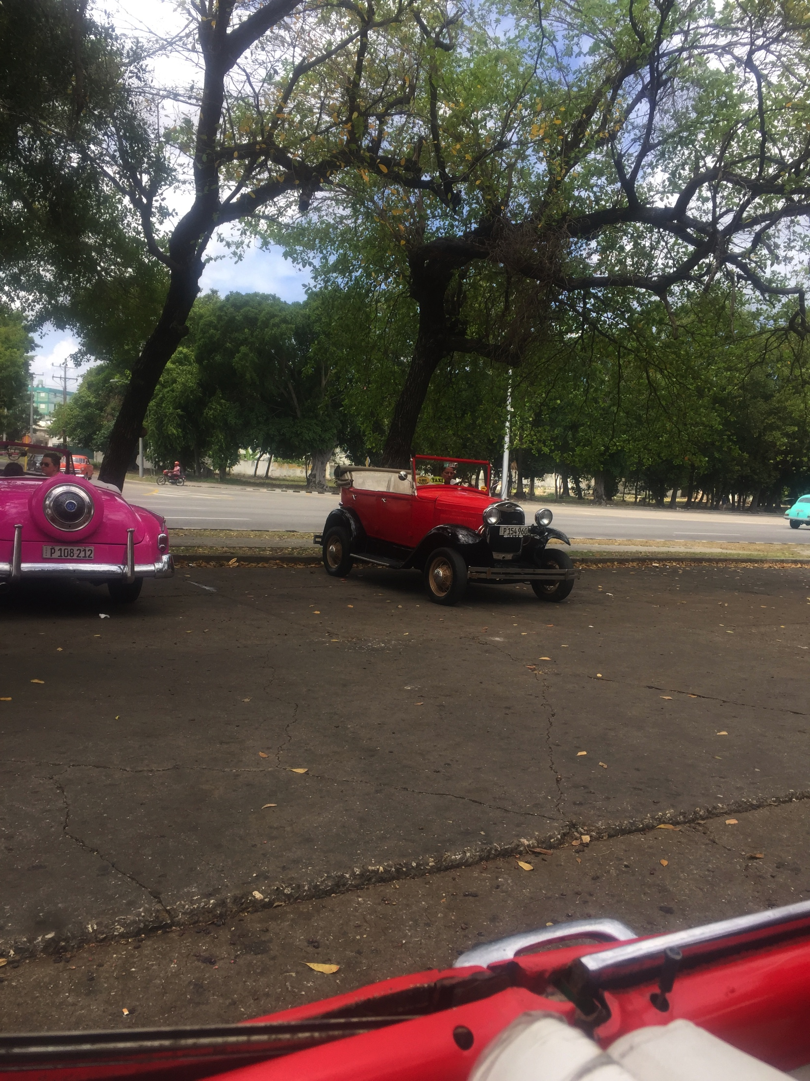

Slide 48
Newer Cars

Slide 49
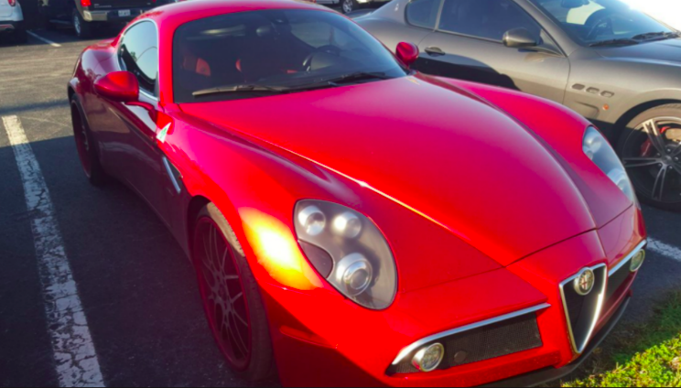
Yoenis Cespedes’ car
Notes:
Cuban-born stars in MLB have NICE cars

Slide 50
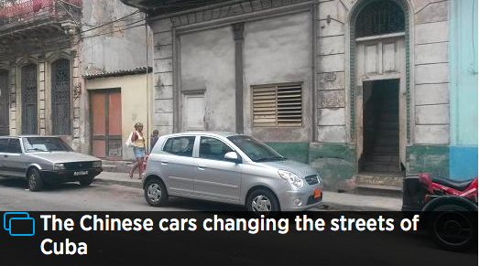
Can you buy a new car in Cuba?
Notes:
Chinese car Photo by CNBC Matt Clinch
Only a 400 % markup – about $80,000 for this car

Slide 51
Commercial Transportation
New
Old
Creative

Slide 52
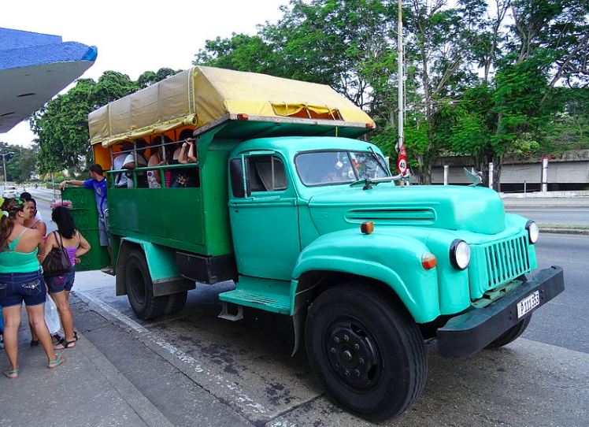
Truck Bus

Slide 53
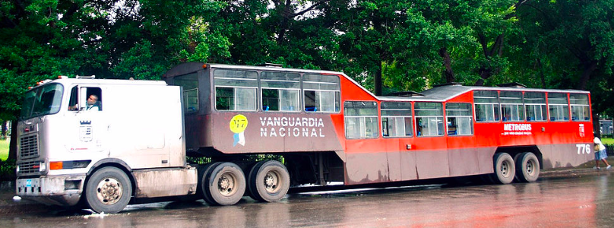
Camel Bus

Slide 54
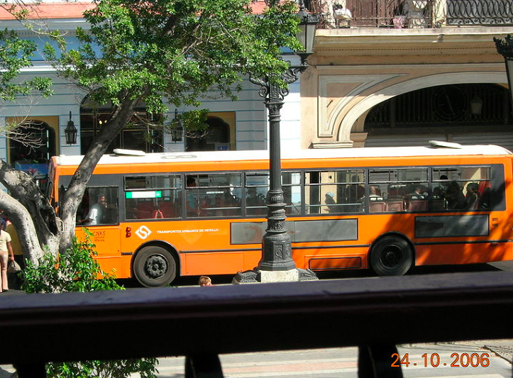
Yellow School Bus – not just for children
Notes:
Decommissioned in Seville, Spain 2014, now in Cuba

Slide 55
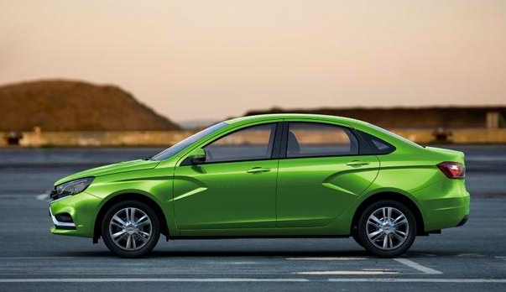
New Lada Vesta
Photo courtesy Automotive News Europe 2017

Slide 56
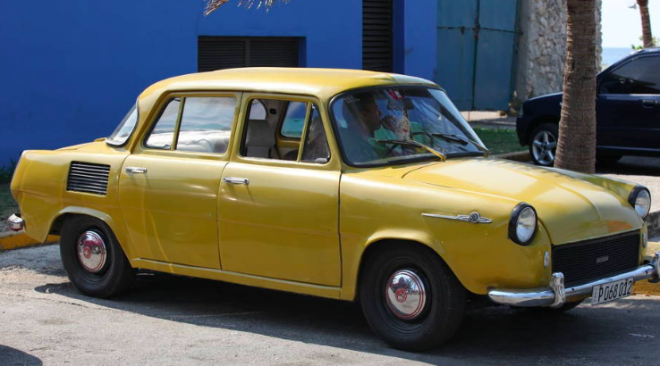
Older Skoda (Czech)

Slide 57
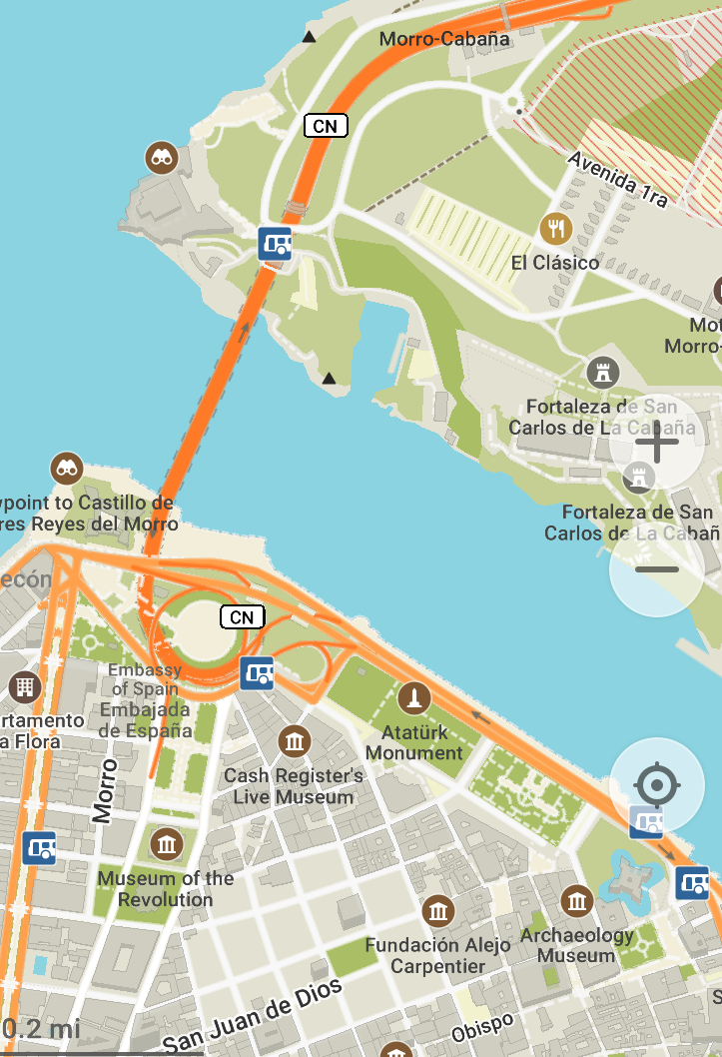
Automobile
Museum
X
Was in old
building in
Plaza de Armas
Square
Now?

Slide 58
Thank You!
(and happy motoring)

Slide 59
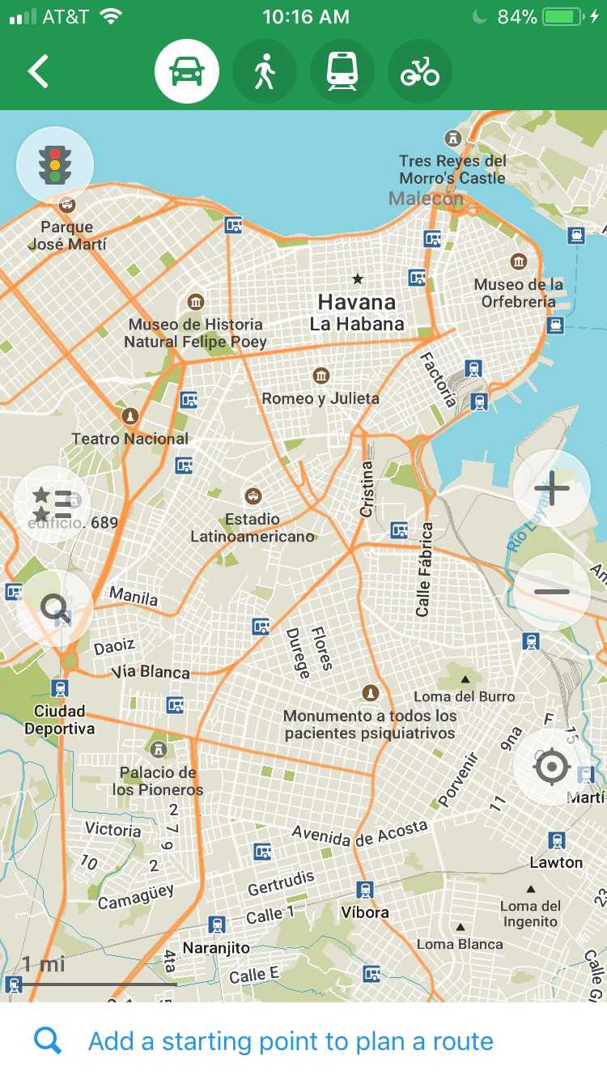
Maps.me

