Slide 1


Slide 2
The Vikings
Ronald J. Leach

Slide 3
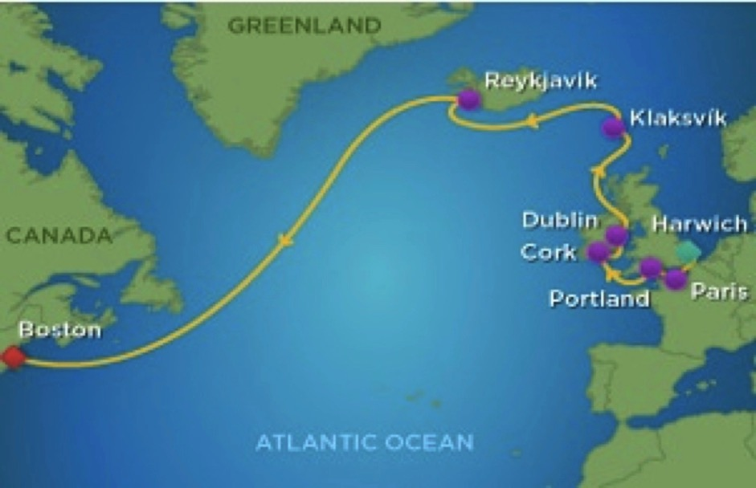
Where does this ship travel?

Slide 4
Did the Vikings travel there?

Slide 5


Slide 6
The Vikings
Who?
What?
Where?
Why?
When?
Notes:
When is easiest: 700 to 1100

Slide 7
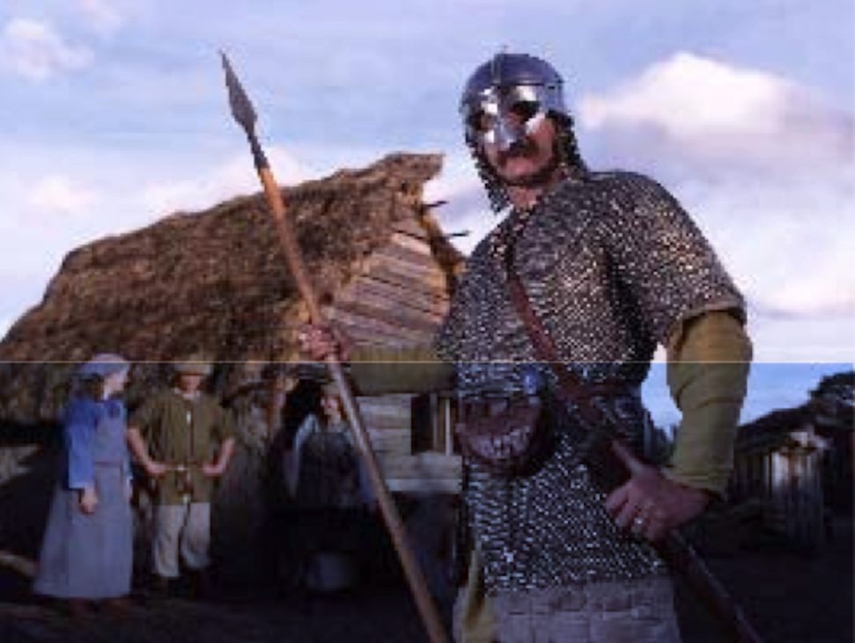
What were they like?

Slide 8
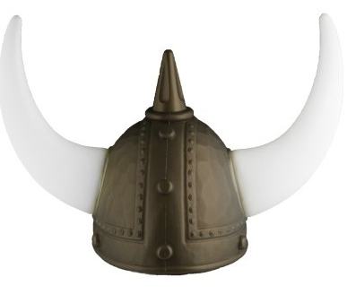

Slide 9
No !

Slide 10


Slide 11
No !

Slide 12
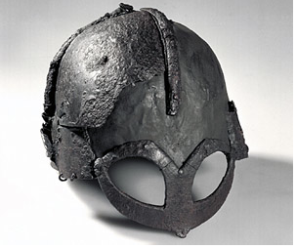

Slide 13
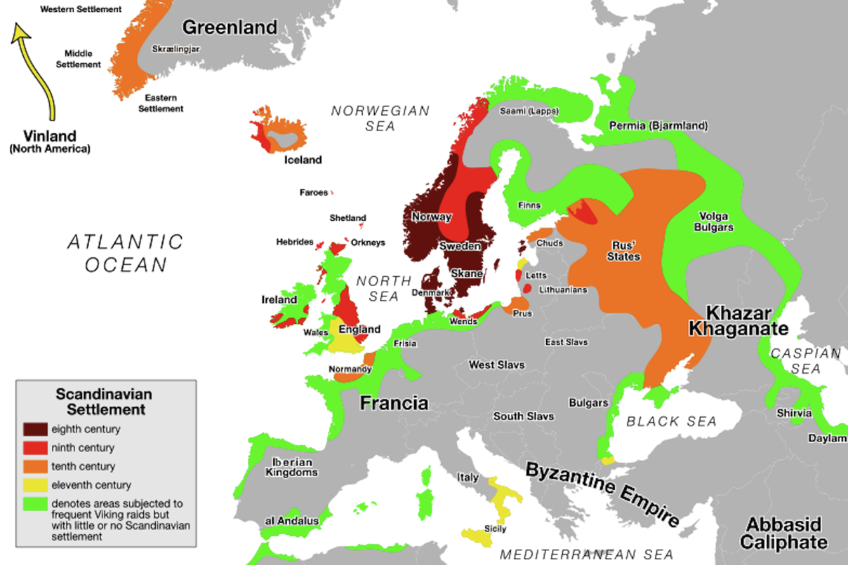

Slide 14
Where were they going?
Norsemen and Danes often went west and south
Swedes often went east

Slide 16
Why did they go a-Viking?
Primarily farmers and traders
BUT ...
Population pressures
Little good farmland at home
Opportunity: Europe was weak

Slide 17
Why did they stop a-Viking?
Settling down, intermarriage
More resistance in Europe

Slide 18
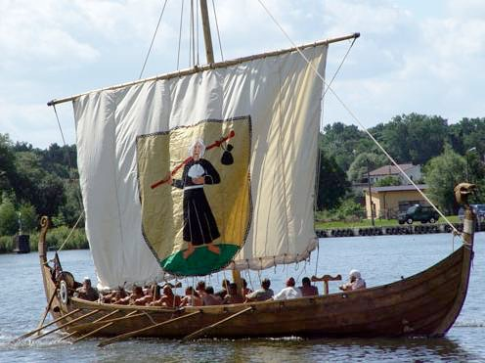
Source: Wikipedia

Slide 19
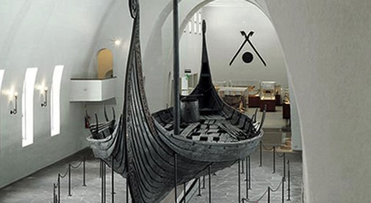

Slide 20
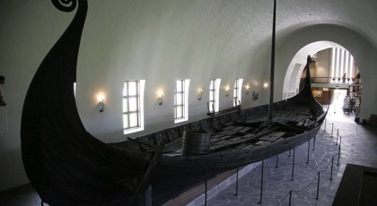

Slide 21
Vikings in England, Scotland

Slide 22


Slide 23
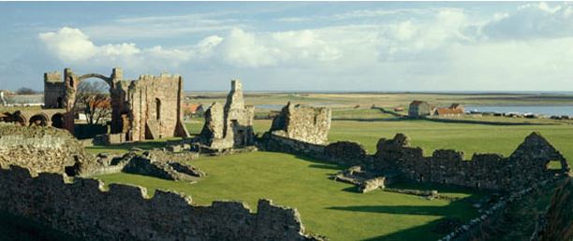
Lindisfarne

Slide 24
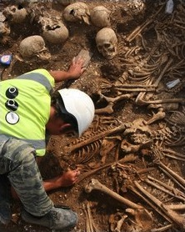
Weymouth (Portland)

Slide 25
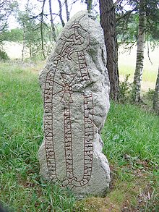
Viking conquest of England

Slide 26
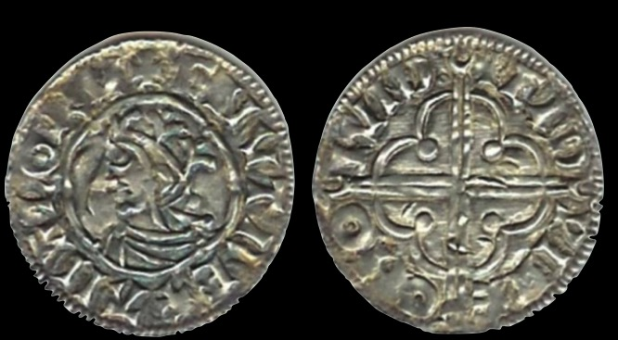
Coins from King Canute

Slide 27
Vikings in France
Parisi fortify their city
Normandy
William the Conqueror

Slide 28


Slide 29
Vikings in Ireland

Slide 31
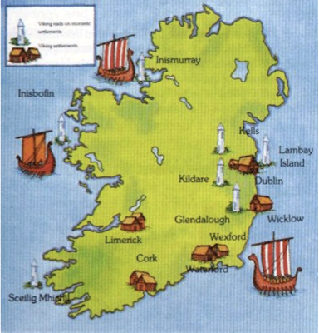

Slide 32
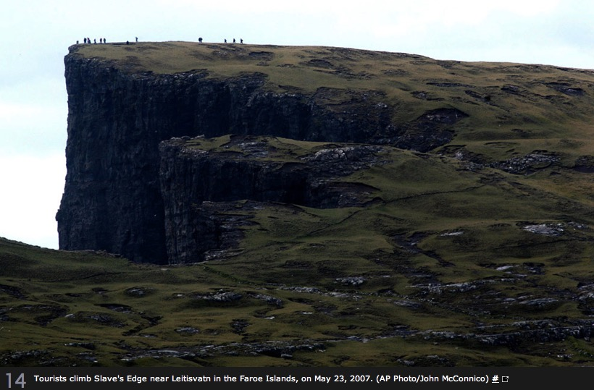

Slide 33
Vikings in Iceland, Greenland

Slide 34
Leif Erickson
Son of Erick the Red
Left Greenland in 1002
Helluland ("Flat Stones Land"), Baffin Island ?
Markland ("Woodland"), Labrador ?
Vinland (Massachusetts), Newfoundland
Saga of the Greenlanders
Notes:
Icelandic spar is polarized - shows the direction of the sun even on cloudy days.

Slide 35
Vikings in America

Slide 36
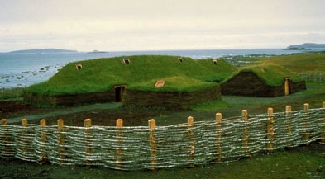
L’Anse Aux Meadows

Slide 37
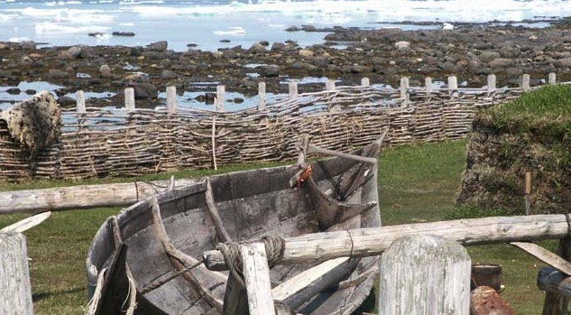
Boat at L’Anse Aux Meadows

Slide 38
Viking navigation

Slide 39
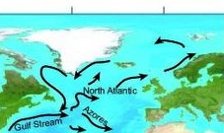

Slide 40
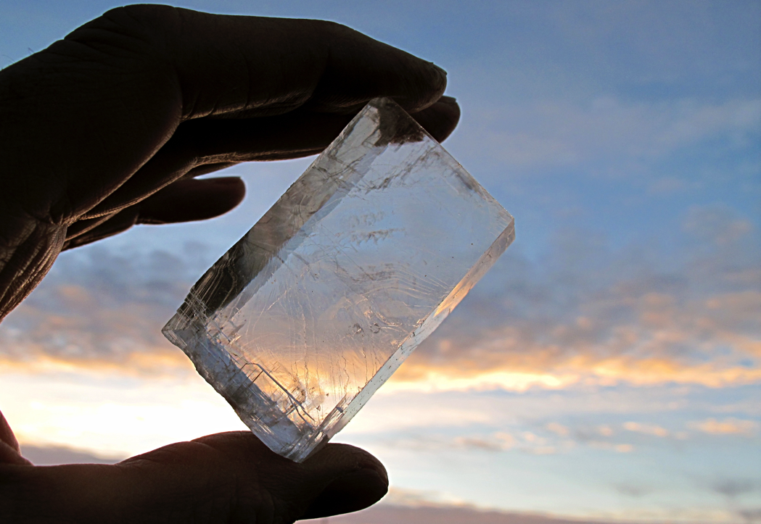

Slide 41
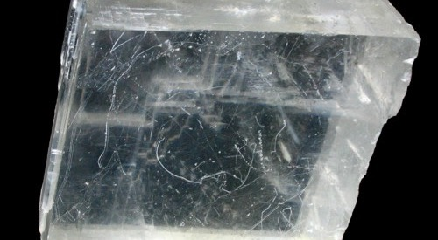

Slide 42
What did the Vikings leave?
Genetic, cultural heritage
Wodin’s Day, Thor’s Day, Freya’s Day
Colonies in England, Scotland, France, Ireland, Iceland, Greenland, ...
Helped unify Russia
Major influence on Ireland, England, France,…
Little in North America

Slide 43
Thank you

