Slide 1
iPhones and iPads and iTunes, Oh My!
Ronald J. Leach

Slide 2
About me (and you)
Long-time Apple user.
Retired as Professor of Computer Science at Howard University, Former Department Chair.
We sent more students to Microsoft in 2004-5 than any other school in the U.S.
Author of multiple books, many in electronic form on iBooks, Amazon, Barnes and Noble.
Cruise lecturer, especially Identity Theft.

Slide 3
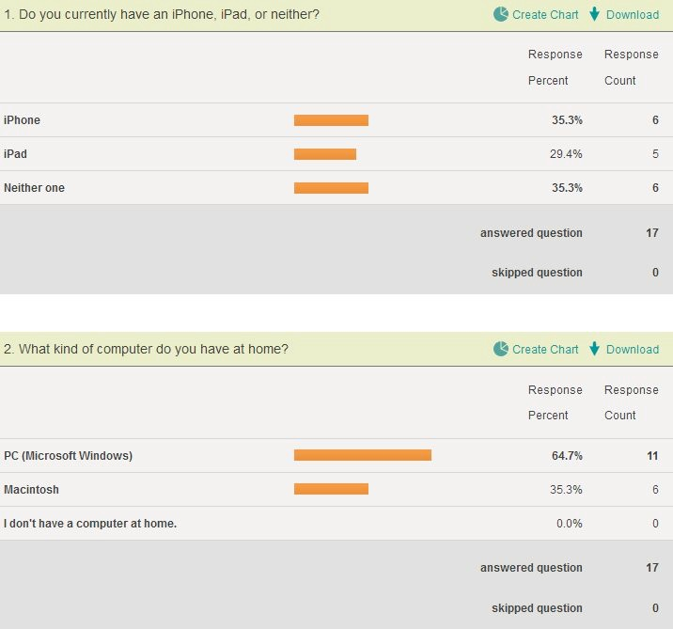

Slide 4
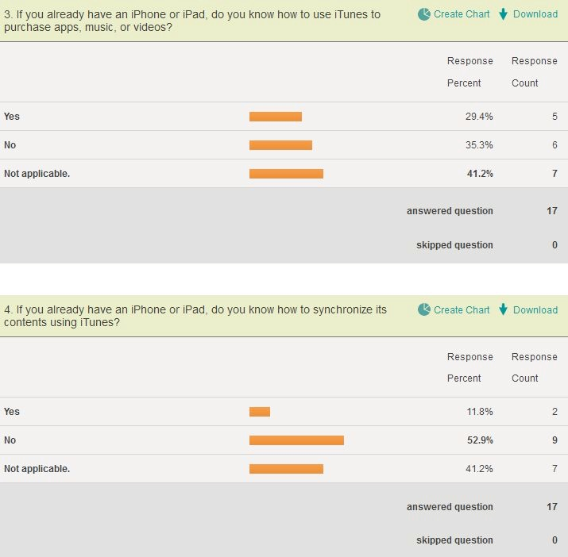

Slide 5
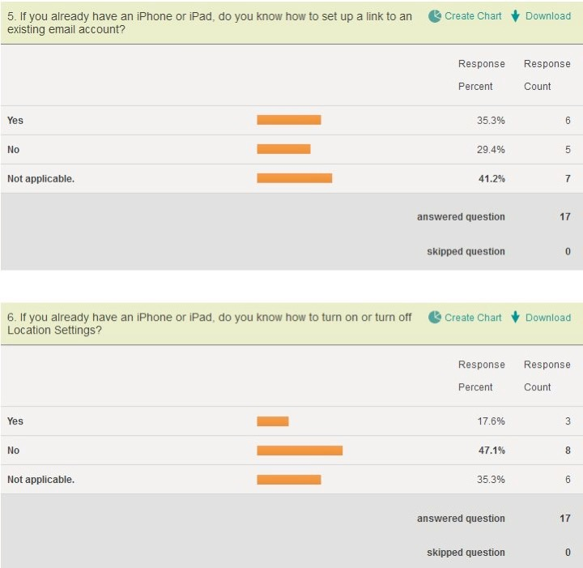

Slide 6
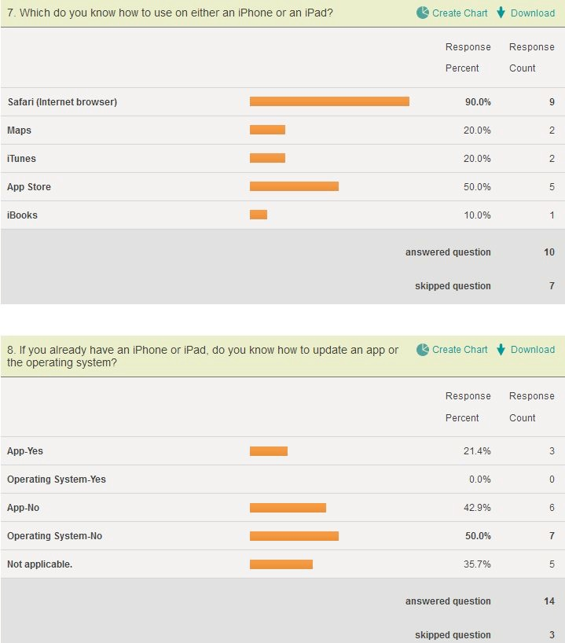

Slide 7
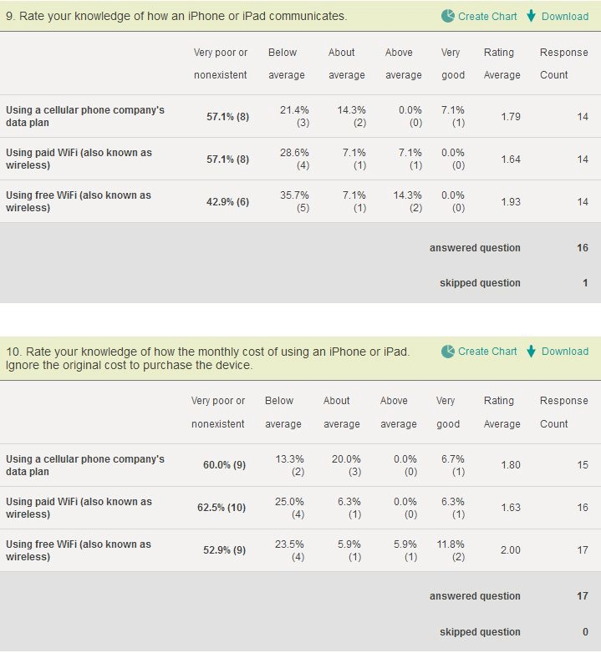

Slide 8
Outline of Workshop
Overview of iPhone and iPad.
The Virtual Keyboard.
Overview of iTunes and the App Store.
Synching with iTunes.
Communications.
Emphasis is on interaction – please ask lots of questions.
Feel free to work together.

Slide 9
Two Revolutionary Devices
The iPhone was the first general-purpose smart phone.
The iPad was the first general-purpose content display device.
Both have far more uses than what was originally expected.

Slide 10
Why so useful and powerful?
Seamless integration with multiple devices.
Seamless integration of text and graphics.
Seamless integration with a revolutionary idea – the iTunes store.
A revolutionary way of obtaining software – and a revolutionary way of pricing it.

Slide 11
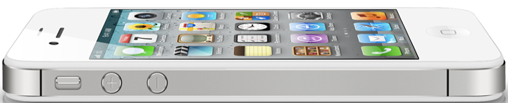
iPhone

Slide 12
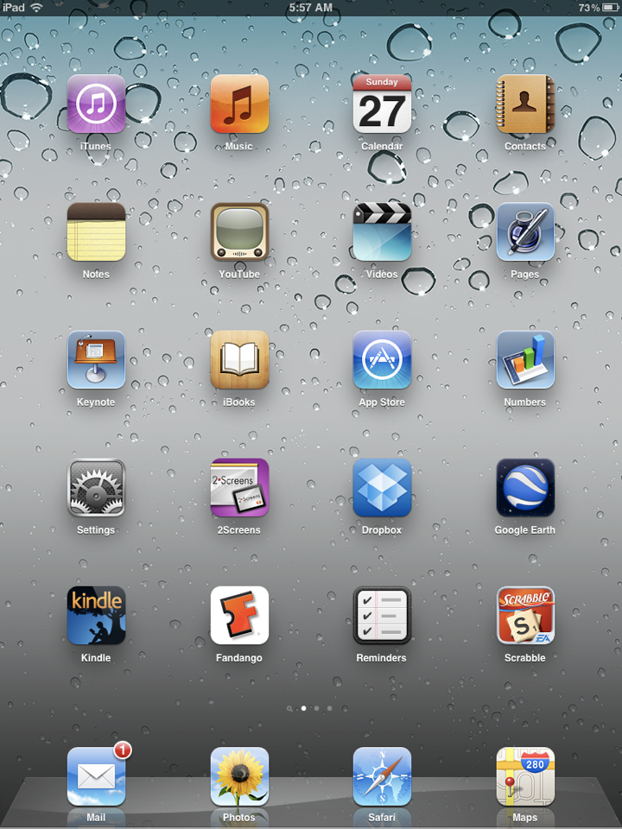

Slide 13
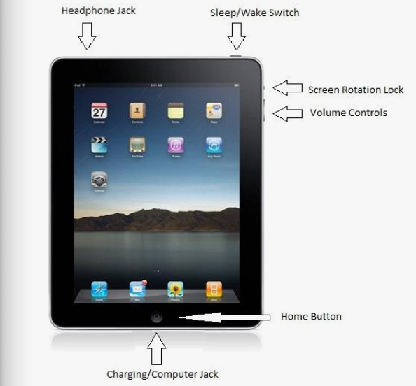
iPad

Slide 14
Business use of iPhones and iPads
Apple, for point-of-sale transactions with credit cards.
Sears.
An auto glass company.
Royal Caribbean cruise lines for interaction with cruise activities.
Celebrity cruise line for selecting appetizers in a tapas bar-like restaurant.

Slide 15
Newer versions have more features
iPad:
Better reception
Lighter weight
Faster processor
Camera
Better screen resolution

Slide 16
Newer versions have more features
iPhone:
More memory
Better resolution, better reception, faster networks
Better still camera and video camera
video chat
Siri

Slide 17
iPhone vs. Android vs. Blackberry
iPhone – Apple product, tightly controlled device and software.
Android – Google product, cheaper, greater market share.
Blackberry – Research In Motion product, highest level of security, a favorite of corporate IT executives.

Slide 18
Apps
Applications
Sold by the App Store
Use your iTunes account and password
Millions of Apps
Many are useful

Slide 19
Using iPhones
Two primary wireless carriers
  ATT
  Verizon
Also T-Mobil, essentially requires “unlocked” iPhone.
Phone number is set up by carrier or by Apple store.

Slide 20
What can you do on an iPad?
Read books
Email, video chat
See pictures
Watch videos, TV, and movies
Play games
Listen to music
Show presentations

Slide 21
What can you do on an iPhone?
Read books
Email, video chat
See pictures
Watch videos, TV, and movies
Play games
Listen to music
Use it as a phone!

Slide 22
Updating Apps

Slide 23
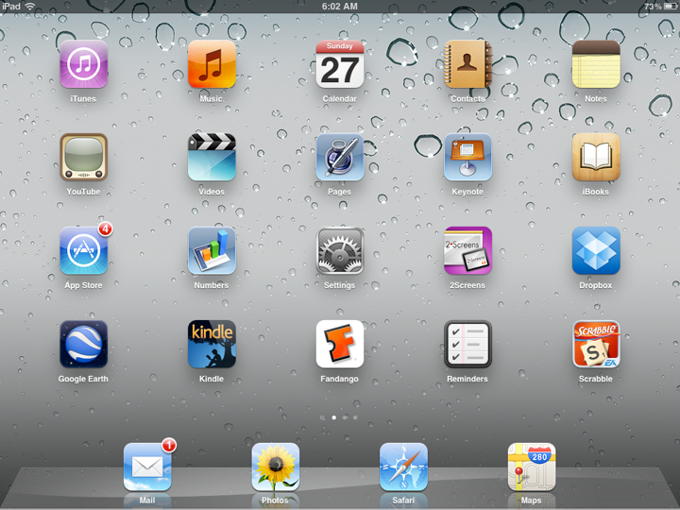

Slide 24
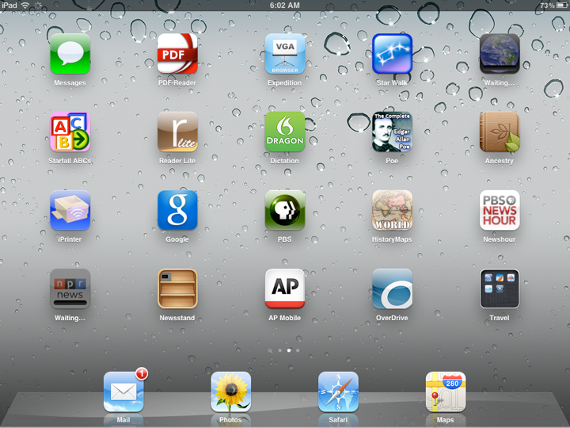

Slide 25
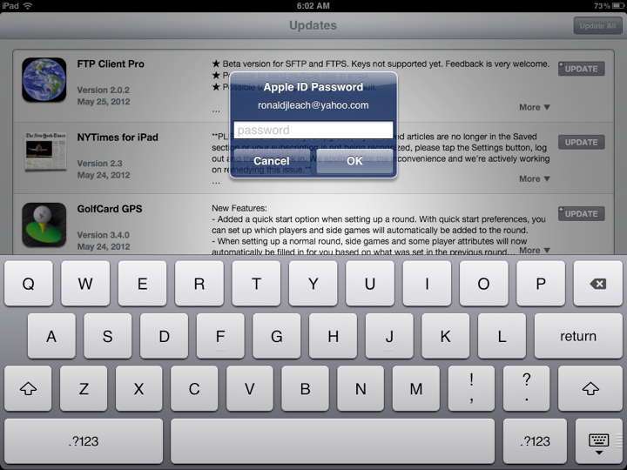

Slide 26
The virtual keyboard
Saves screen real estate
Often adapts to the expected type of input
  text, number, etc
The virtual keyboard has limitations.
Not all keys are visible – you have to switch views.

Slide 27
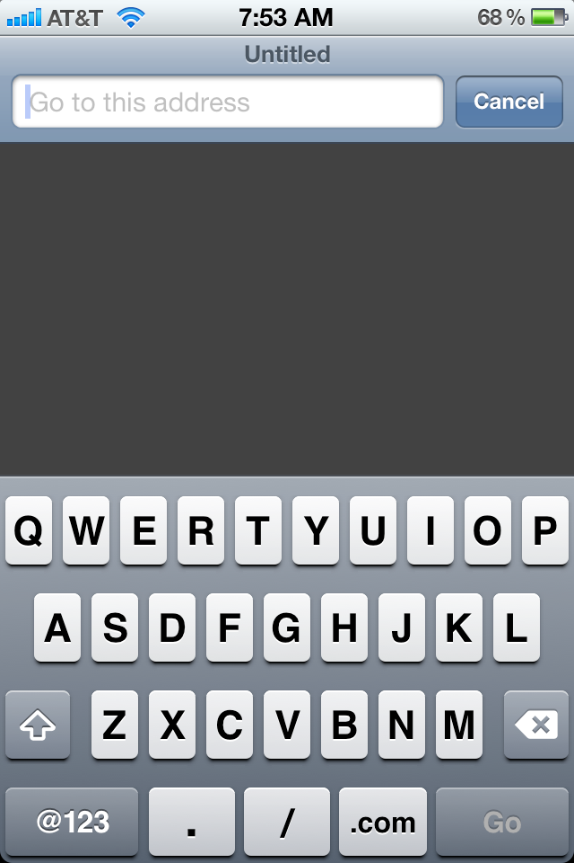
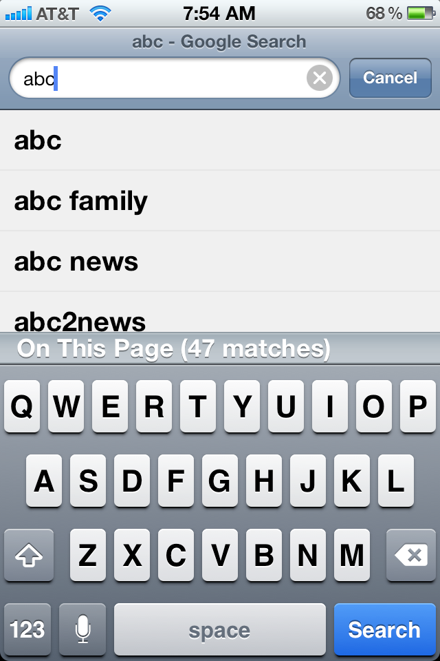

Slide 28
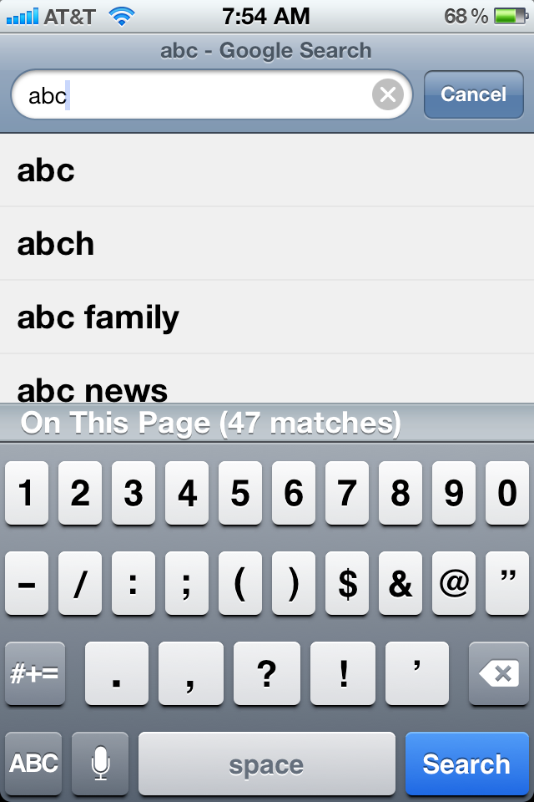
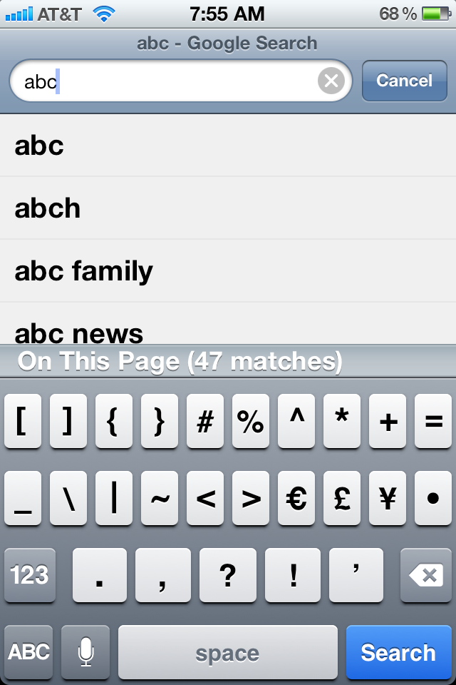

Slide 29
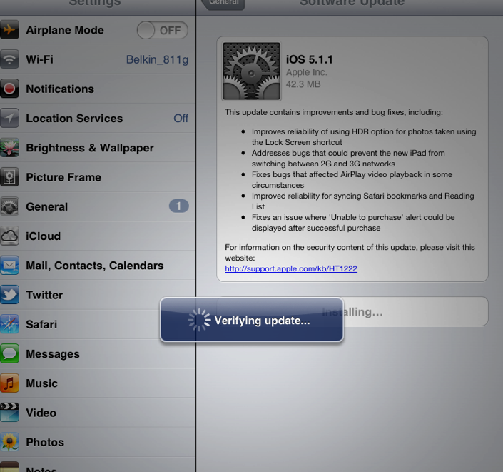
Updating the Operating System

Slide 30
When to update the OS
When there is a red number in the settings icon.
When you get a message when synching in iTunes.

Slide 31
iTunes
Originally a store that sold music.
Now, a way to handle all digital purchases from Apple.
Synchronize purchases for up to 5 devices.
  Music
  Videos
  Books
  Educational classes ... and more

Slide 32
iTunes
Synchronize with a computer (Mac or PC!)
Download iTunes to a “base computer.”
You can copy digital files to the base computer’s iTunes files.
Synchronizing will make sure ALL content is available to all.

Slide 33
Synching
Plug device into home computer’s USB port.
Should start iTunes automatically.
If not, turn on iTunes in home computer.

Slide 34
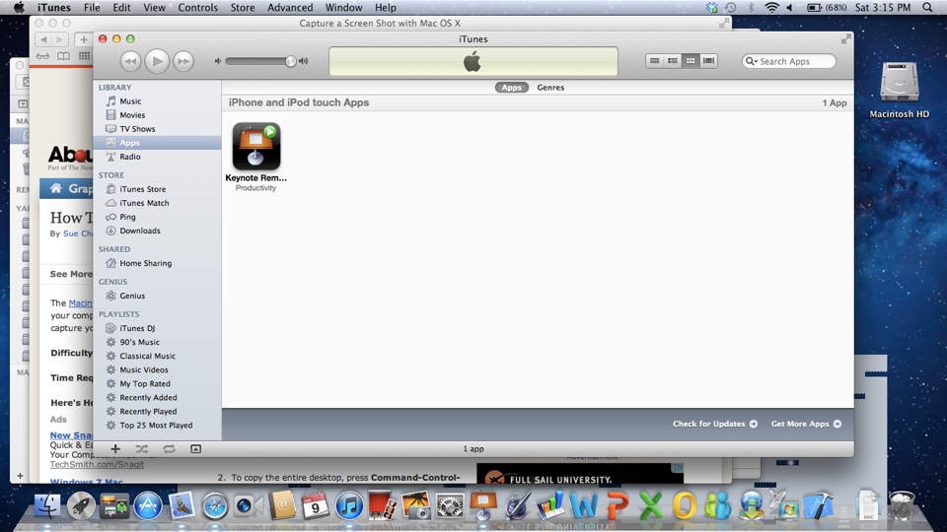

Slide 35
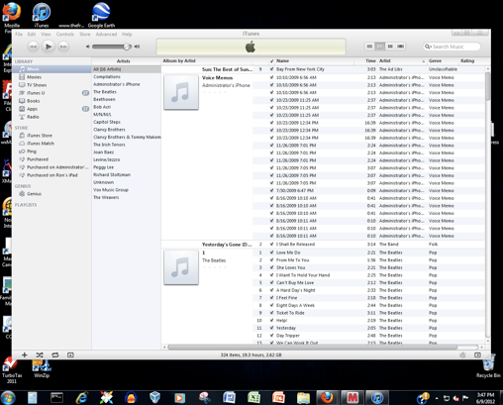

Slide 36
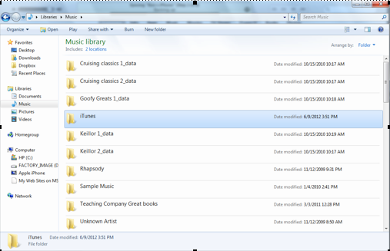

Slide 37
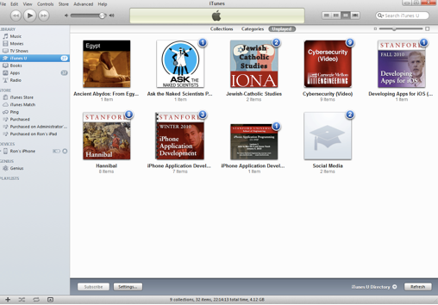

Slide 38
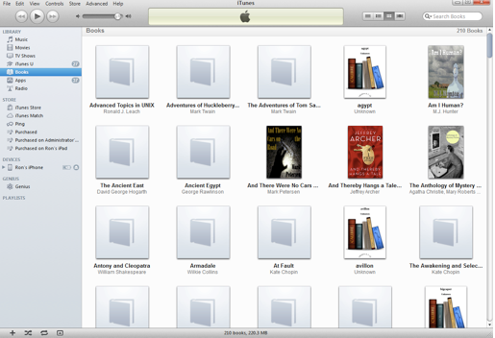

Slide 39
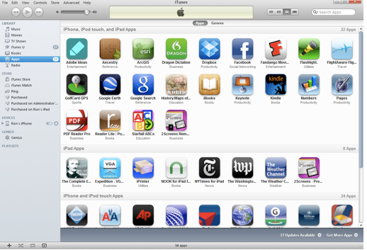

Slide 40
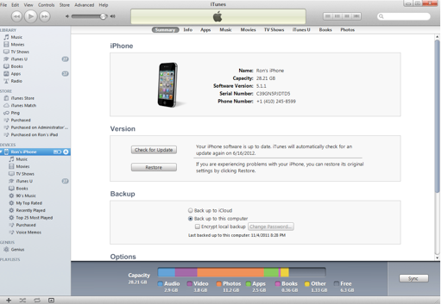

Slide 41
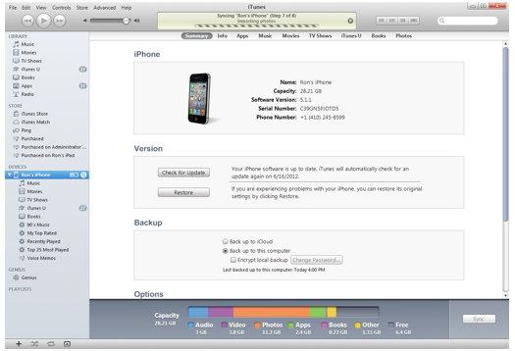

Slide 42
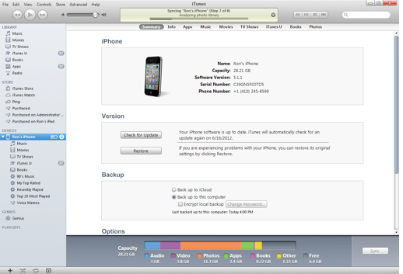

Slide 43
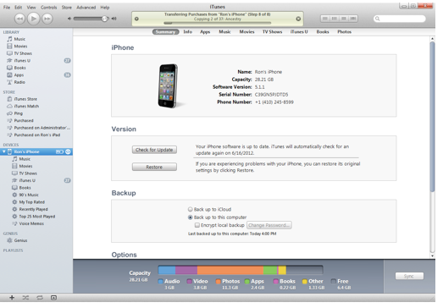

Slide 44
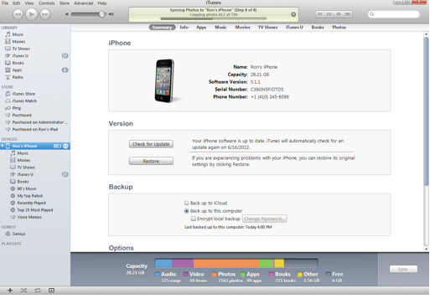

Slide 45
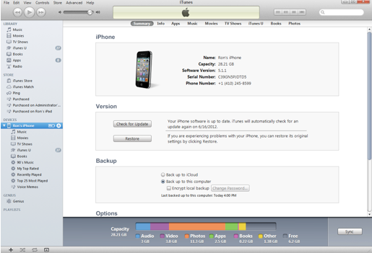

Slide 46
How do iPads communicate?
Using a long-term wireless carrier’s data plan.
Using WiFi (wireless) without a contract from a wireless carrier.
Through Bluetooth (used for hands-free phone calls).

Slide 47
How do iPads communicate?
Through Bluetooth (for communication with other devices).
Through computer-to-computer (ad-hoc) networks for special communications (like this presentation on my Macbook Air portable).
Through iCloud (iPhones, too!)

Slide 48
An identity thief may be watching
Use a strong, impossible-to-guess, password.
Protect your password.
Don’t use “free” wireless.

Slide 49
iBooks

Slide 50
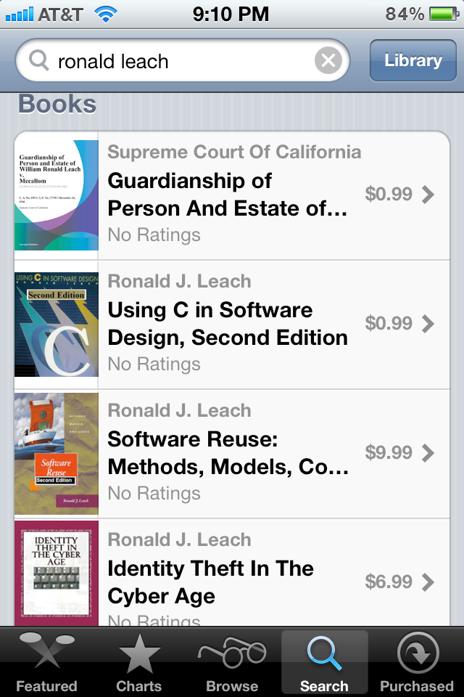

Slide 51
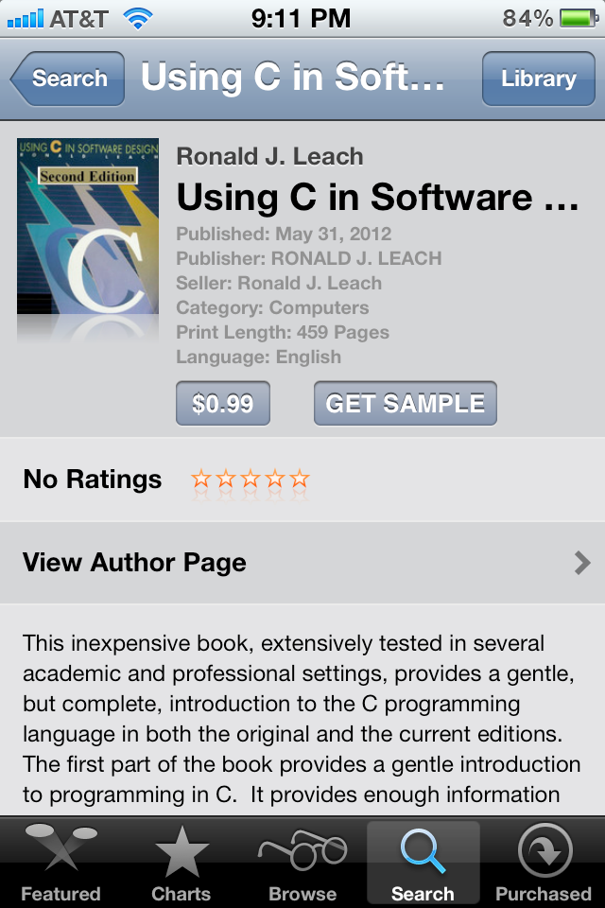

Slide 52
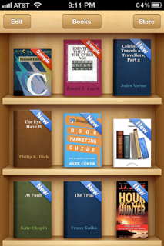

Slide 53
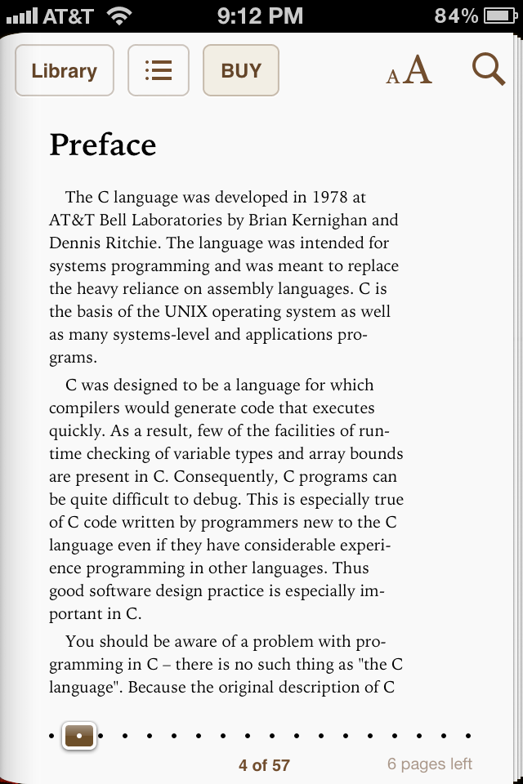

Slide 54
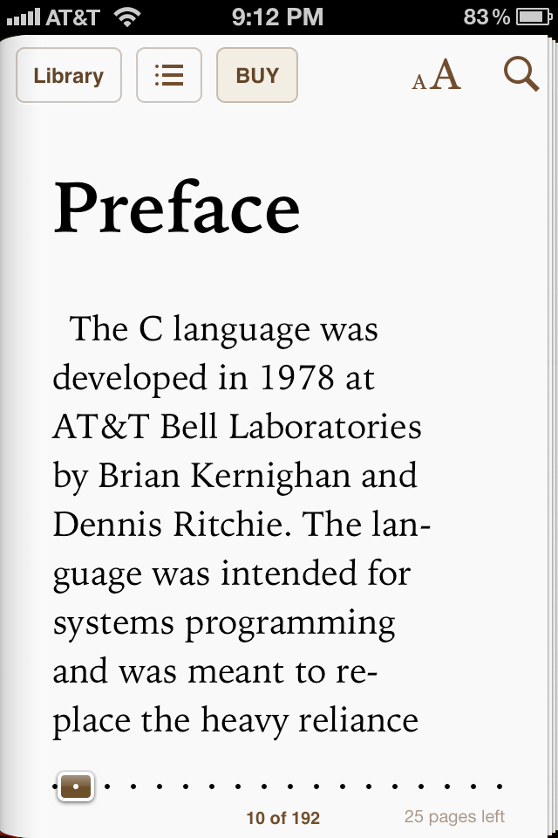

Slide 55
Thank you

